Slide 1
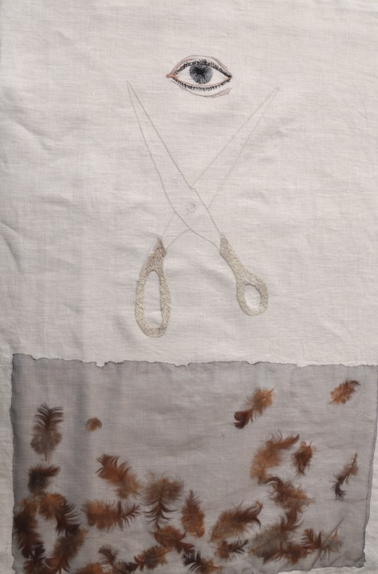
Practicing Slowness
(Detail)
2014

Slide 2
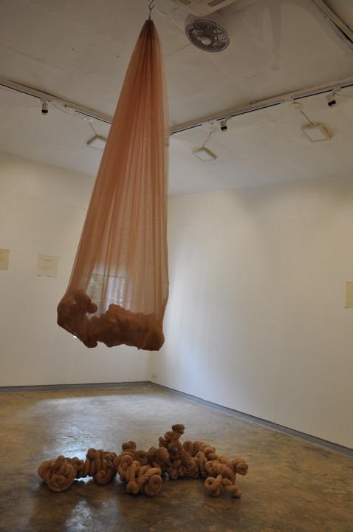
Remnants of Someone Dead in the Body of Someone Living
Dimensions: 220cms x 110cms x 30cms,
(bottom variable)
Year: 2018
Organza and blended cotton fabric,
tea stains

Slide 3
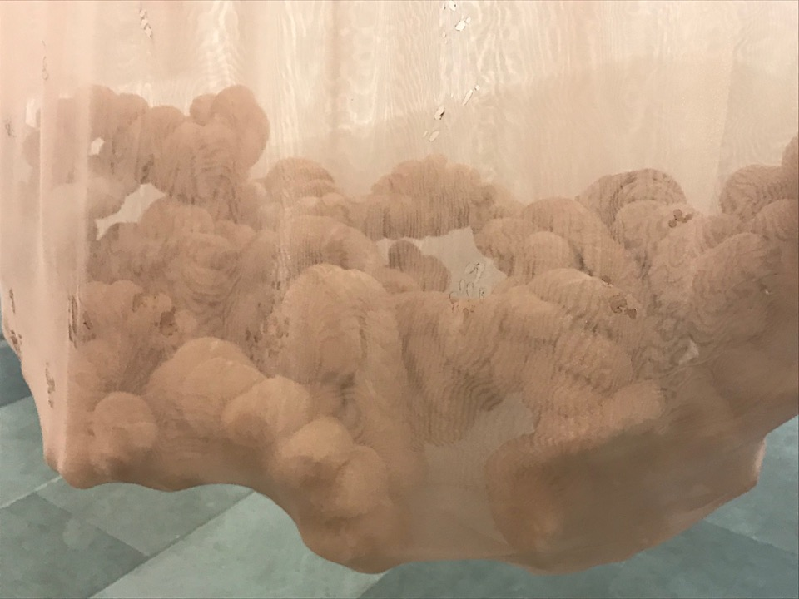

Slide 4
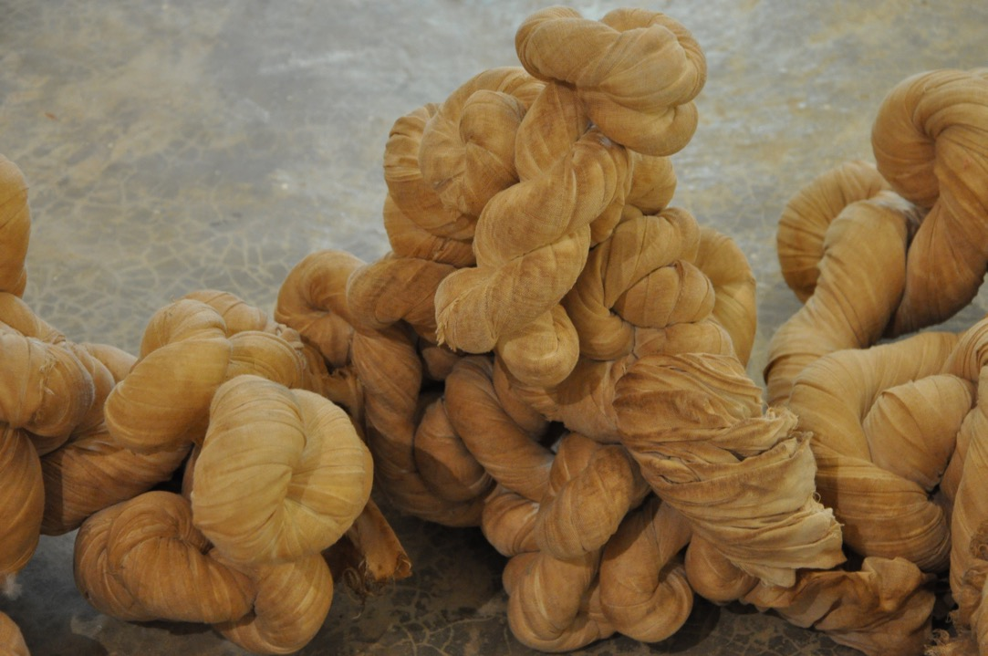

Slide 5
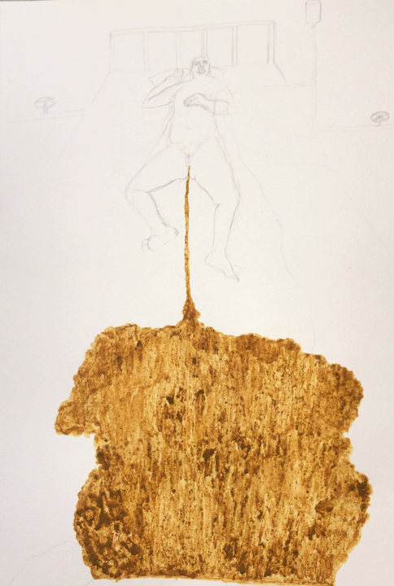
Inflections
(Reflections on Land)
2020-21
Graphite and natural pigments on acid free paper
29.7 x 42 cm

Slide 6
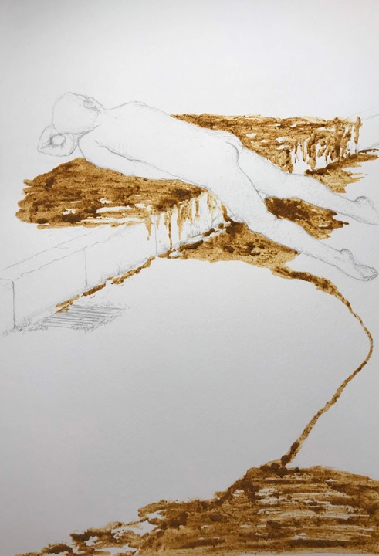
Inflections
(Reflections on Land)
2020-21
Graphite and natural pigments on acid free paper
29.7 x 42 cm

Slide 7
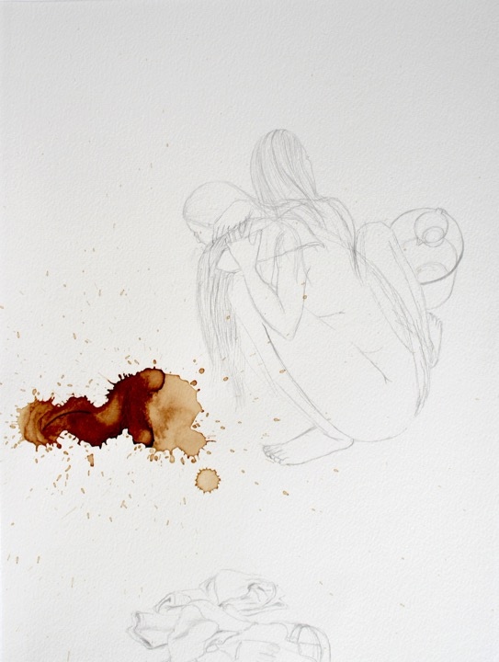
Washing (one’s) Dirty Linen in Public
Art praxis and reflections on Dirt, Linen, the Public and Globalization.
Unpacking -
Elisions and Inflections
Westwerk, Hamburg (November 2021)

Slide 8
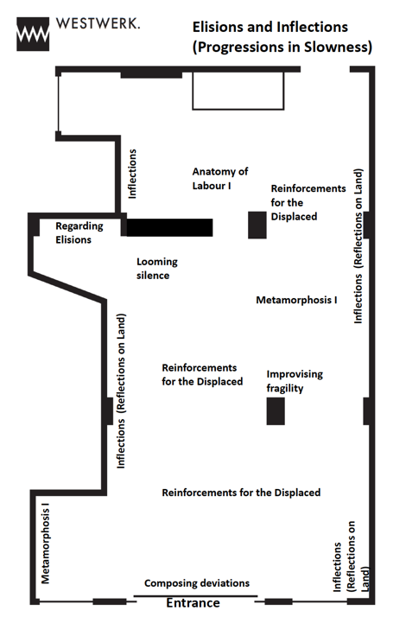

Slide 9
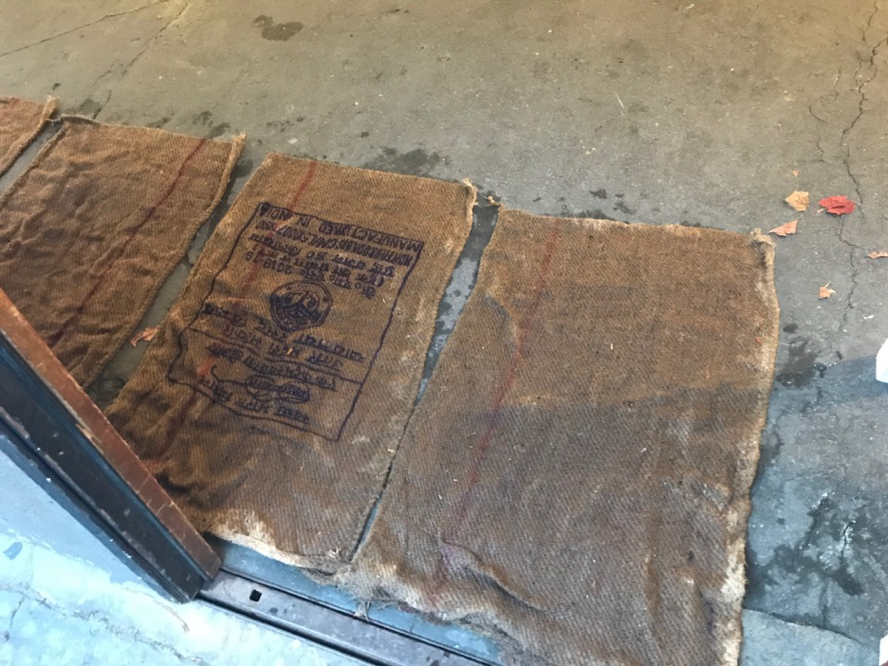
Composing Deviations
Varying dimensions
Jute and water

Slide 10
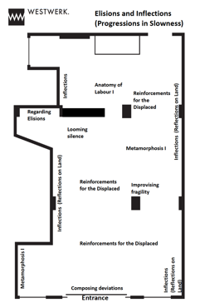
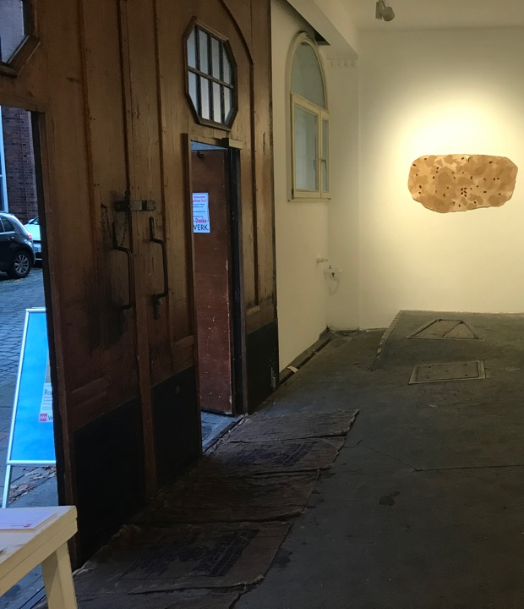

Slide 11
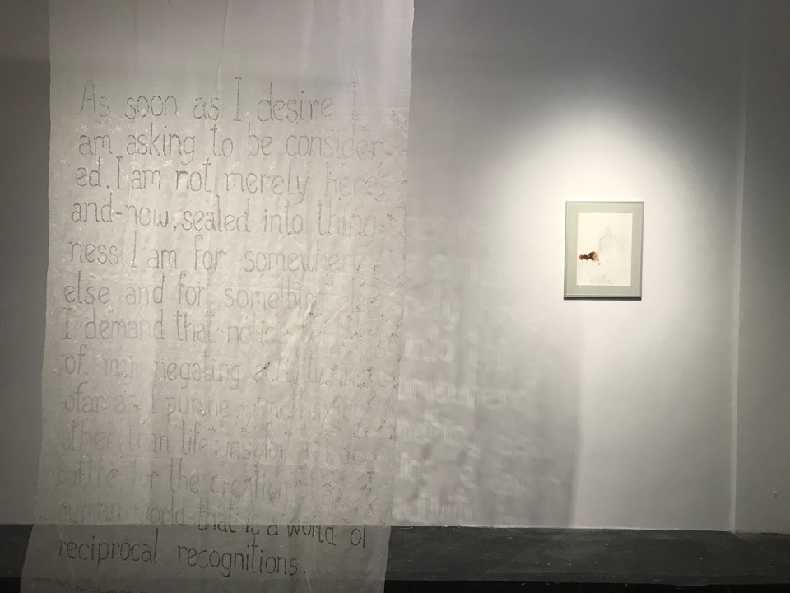

Slide 12
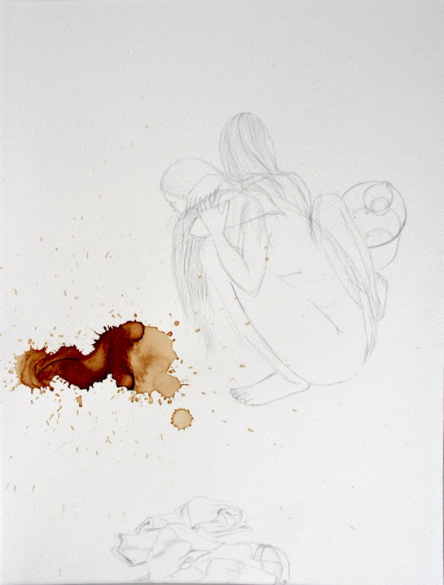
Inflections
(Reflections on Land)
2020-21
Graphite and natural pigments on acid free paper
29.7 x 42 cm

Slide 13
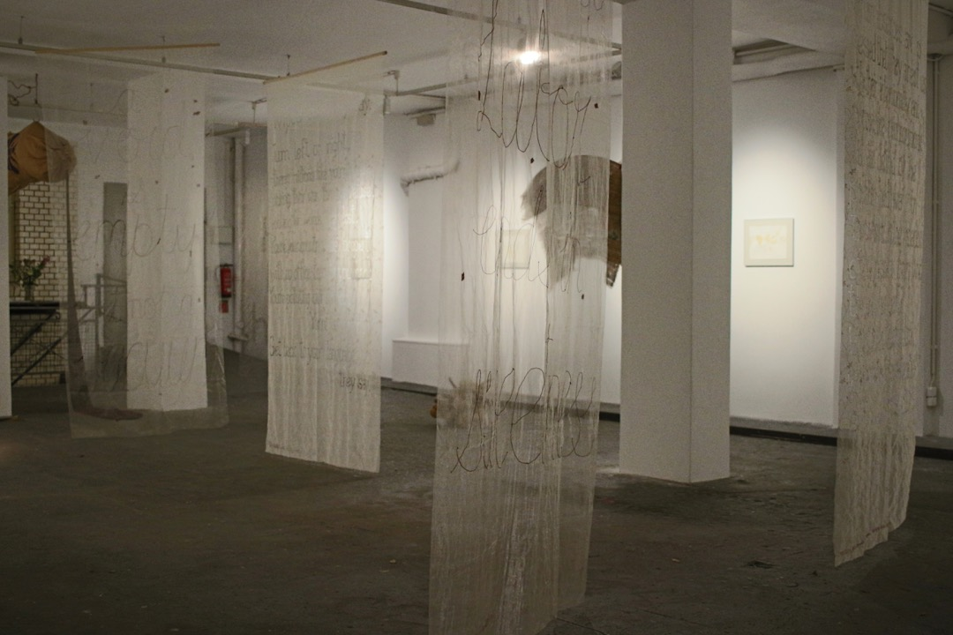

Slide 14
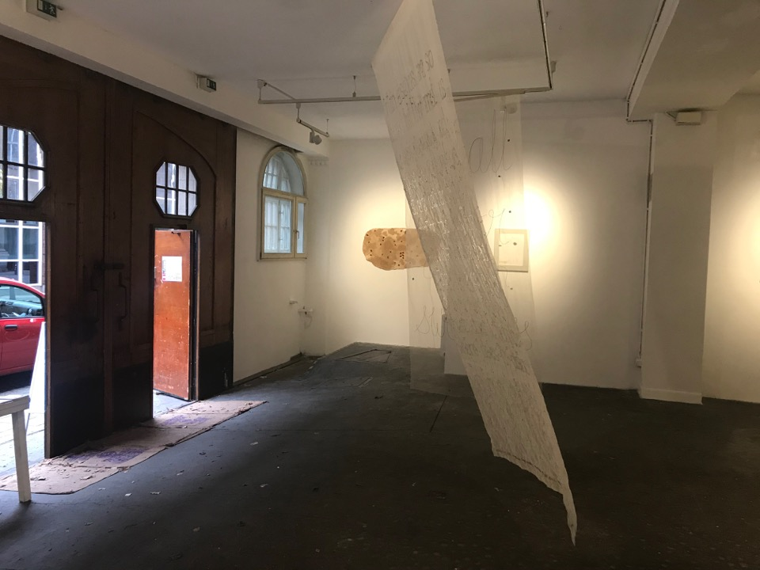

Slide 15
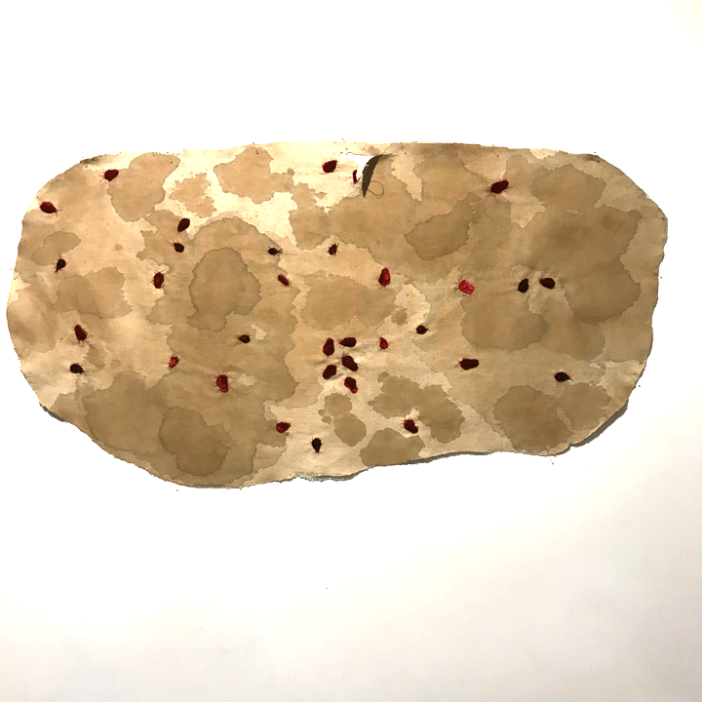
Metamorphosis I
Velvet applique and tea and coffee stains on linen.
Size- 110 x 85 cm
2019

Slide 16
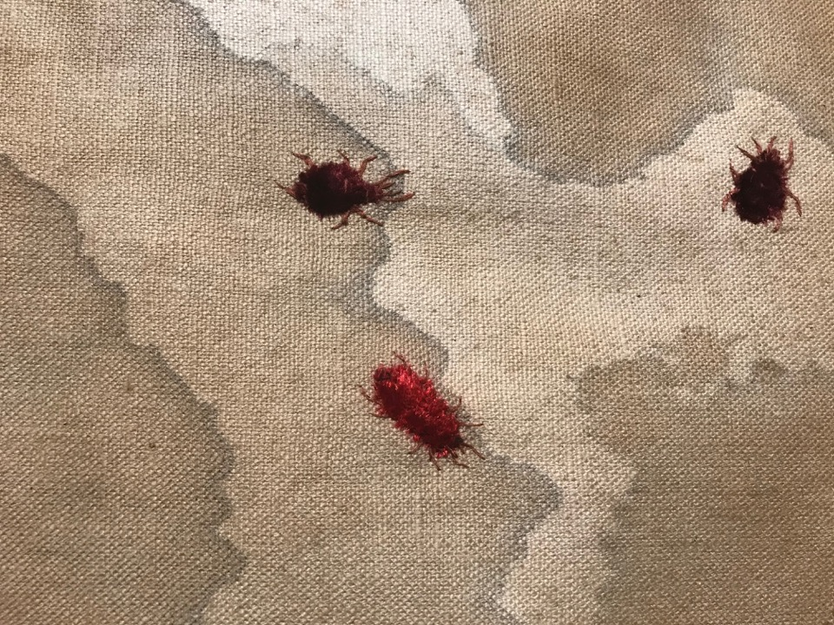

Slide 17
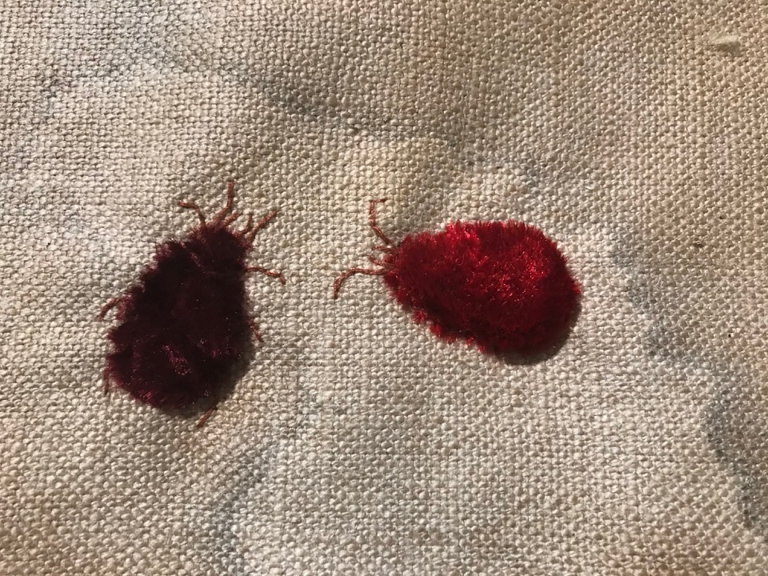

Slide 18
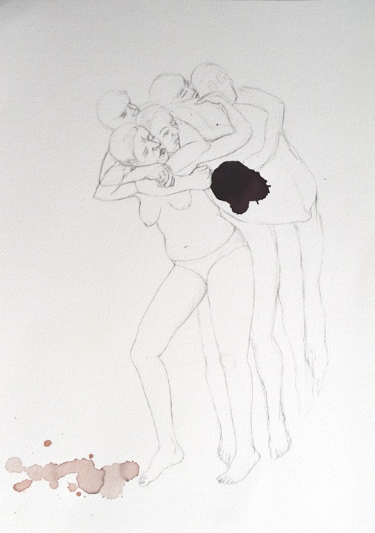
Inflections
(Reflections on Land)
2020-21
Graphite and natural pigments on acid free paper
29.7 x 42 cm

Slide 19
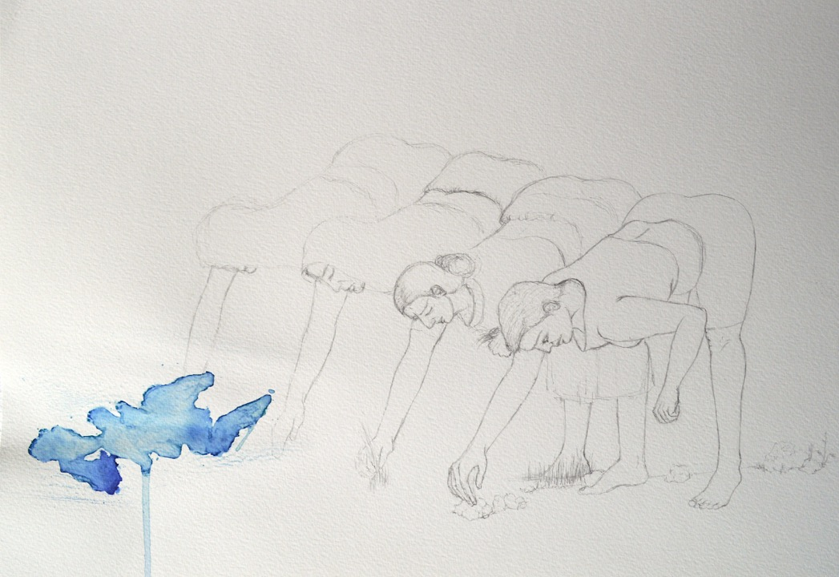

Slide 20
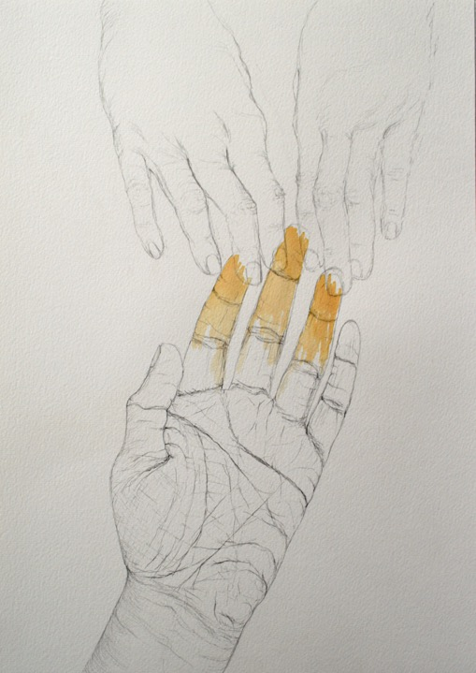
Inflections
(Reflections on Land)
2020-21
Graphite and natural pigments on acid free paper
29.7 x 42 cm

Slide 21
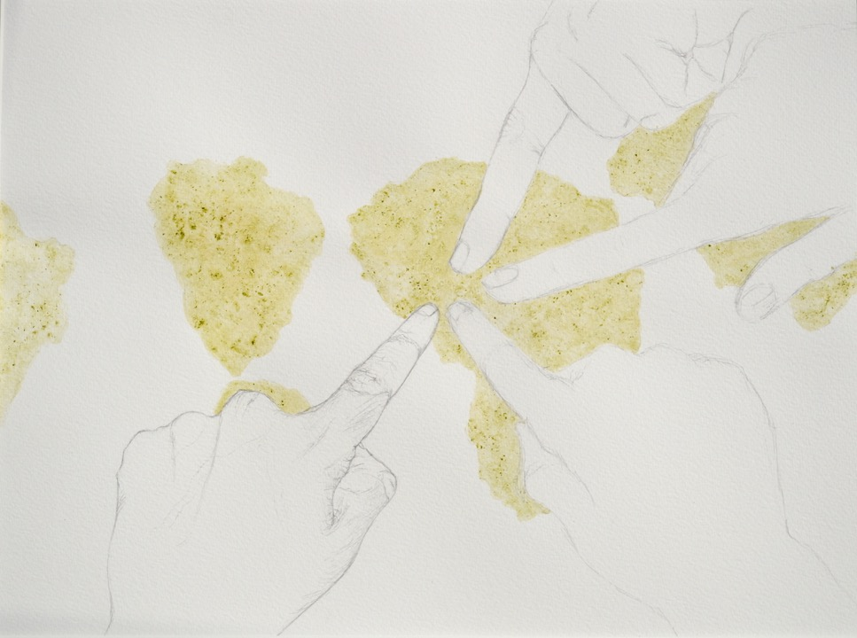

Slide 22
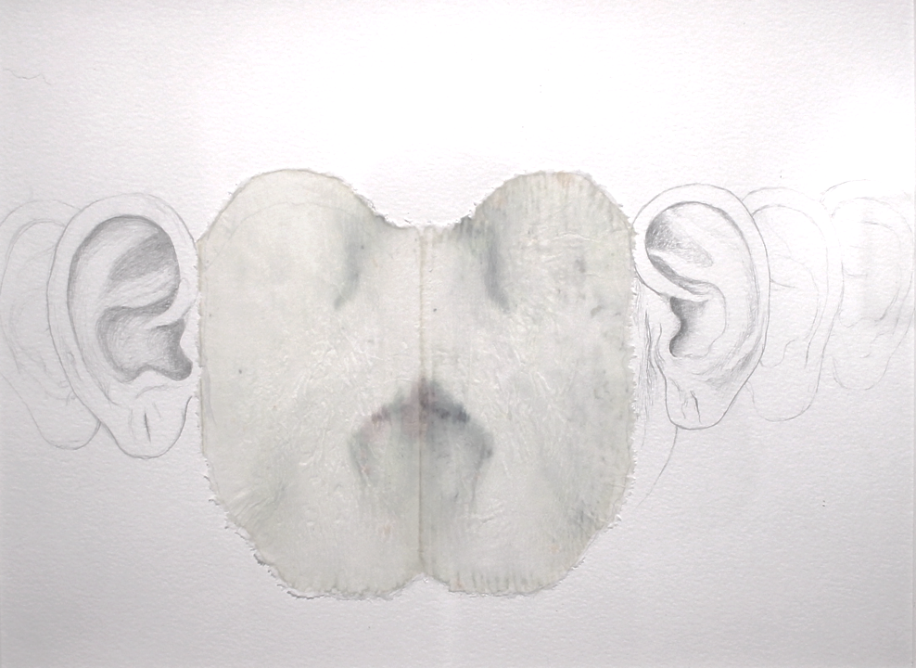

Slide 23
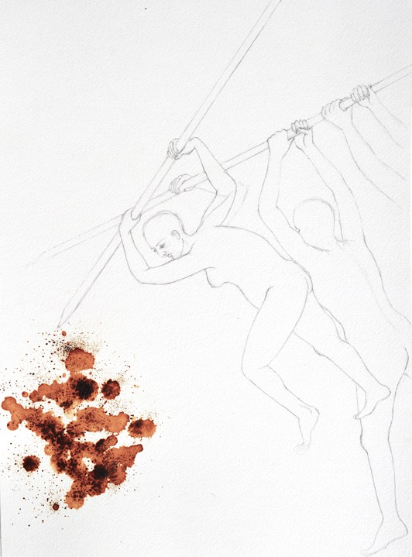
Inflections
(Reflections on Land)
2020-21
Graphite and natural pigments on acid free paper
29.7 x 42 cm

Slide 24
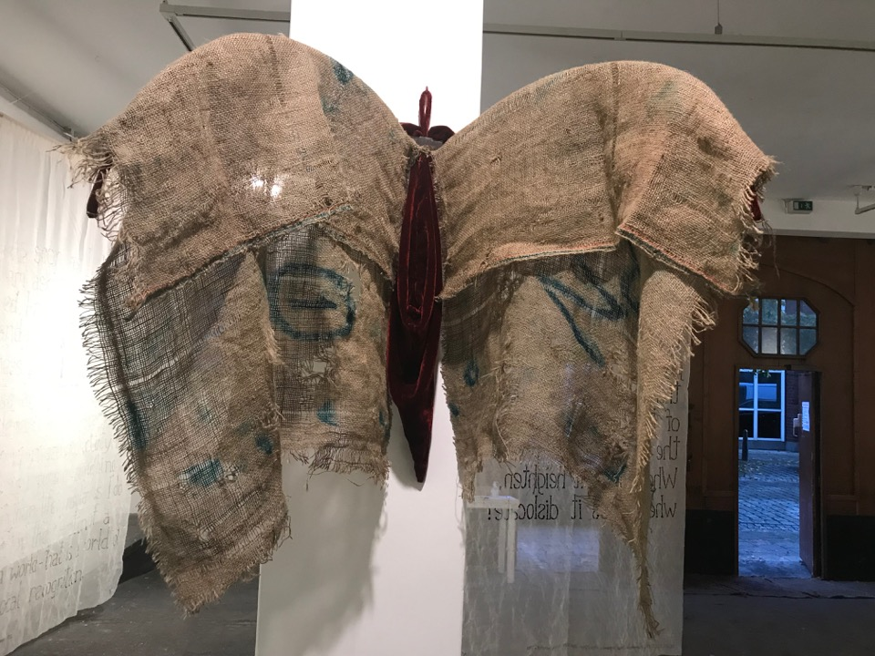
Improvising Fragility
Copper, velvet, jute, iron hammer head.
Variable dimensions when installed
(approximate span: 200cms)
2021

Slide 25
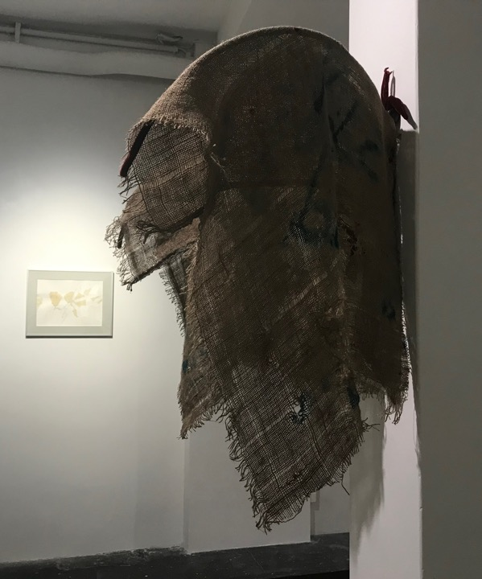
Improvising Fragility
Copper, velvet, jute, iron hammer head.
Variable dimensions when installed
(approximate span: 200cms)
2021

Slide 26
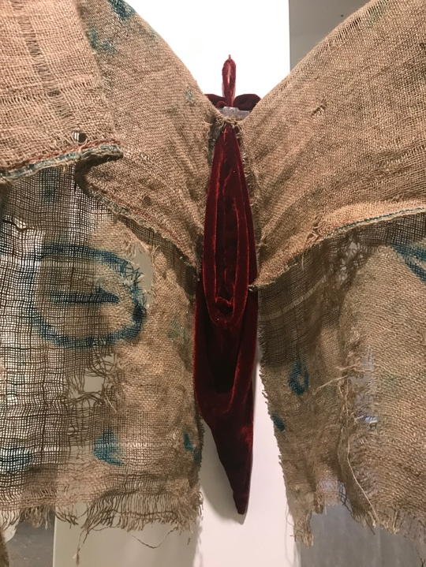

Slide 27
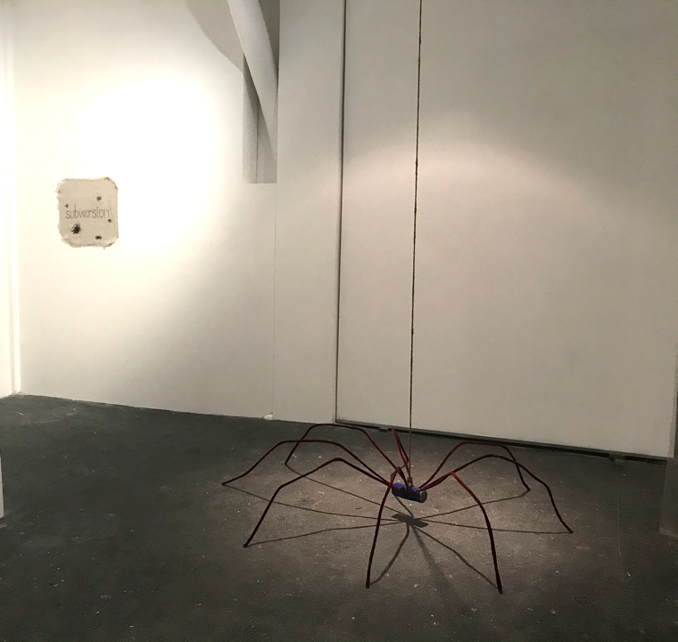
Looming Silence
Copper wires, coir rope, iron hammer head, velvet fabric.
Variable dimensions when installed
(Approximate diameter- 250 cm)
2021

Slide 28
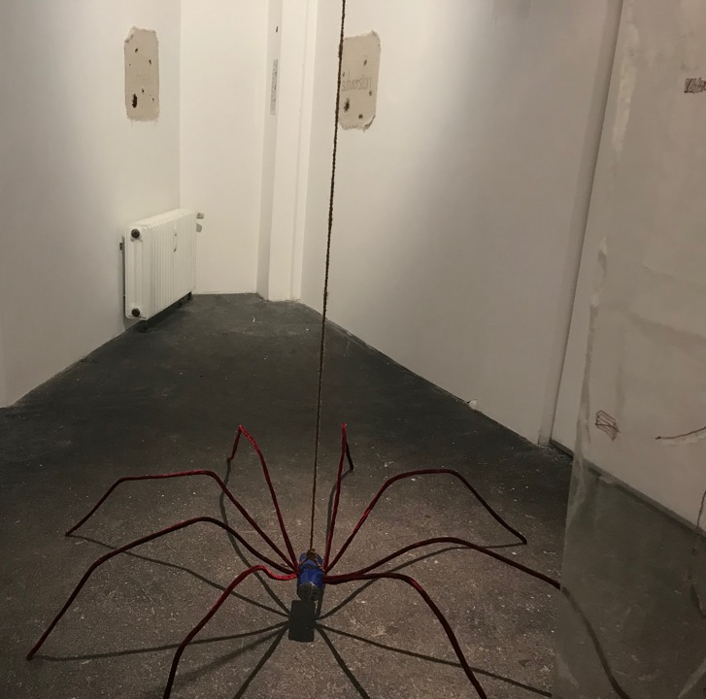
Looming Silence
Copper wires, coir rope, iron hammer head, velvet fabric.
Variable dimensions when installed
(Approximate diameter- 250 cm)
2021

Slide 29
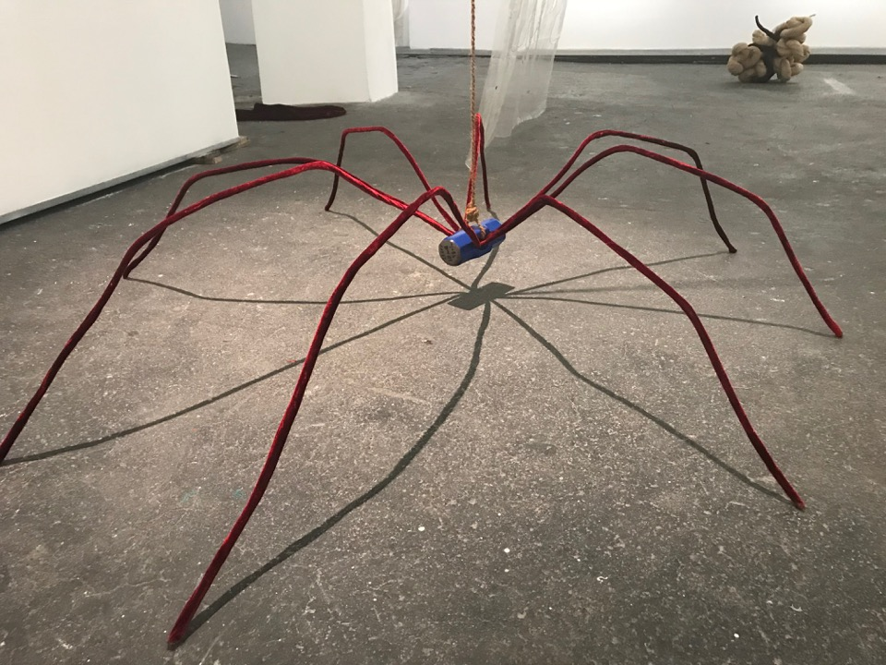

Slide 30
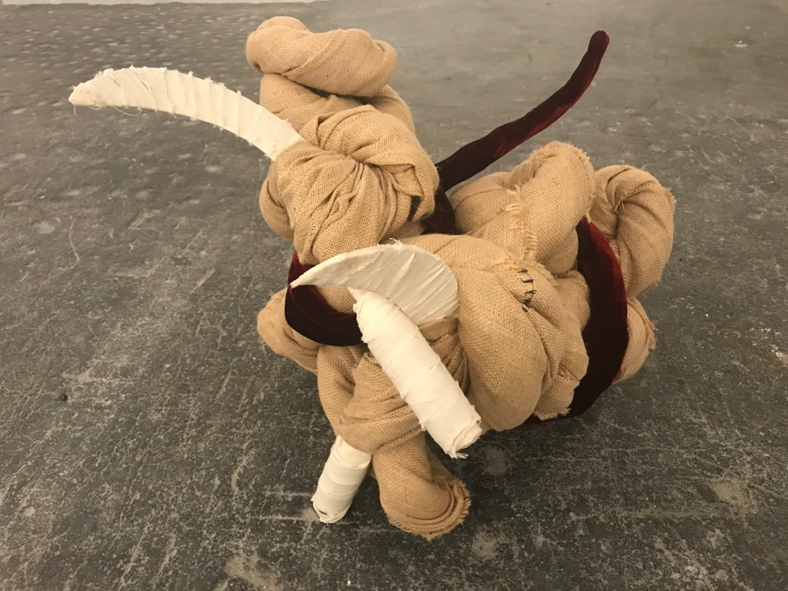
Metamorphosis III
Jute, velvet, farm sickles and cotton
75 x 80 x 65 cm (approx)

Slide 31
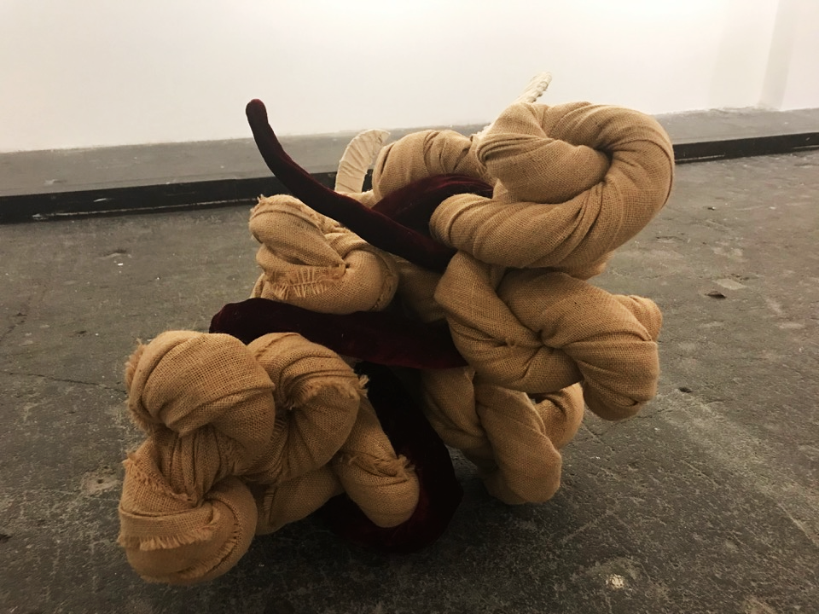

Slide 32
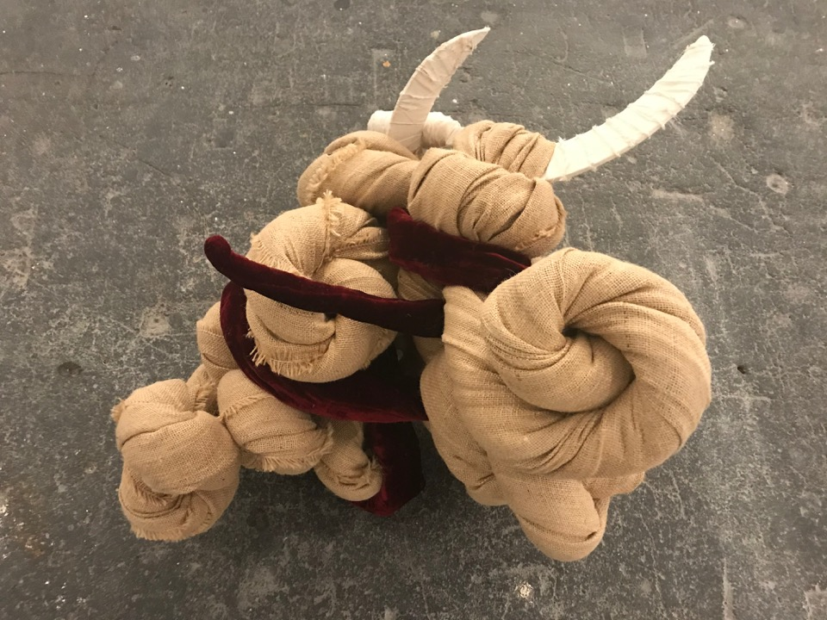

Slide 33
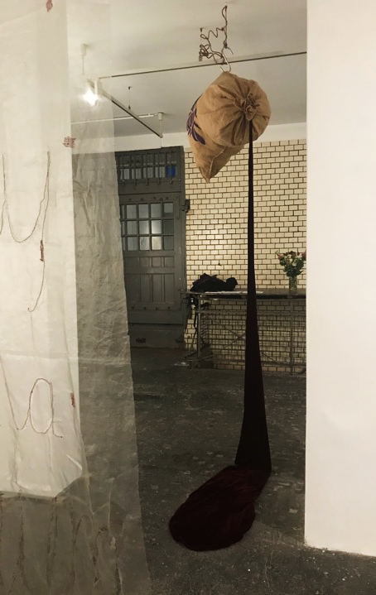
Anatomy of Labour I
Jute, velvet, acrylic ink, coir rope, iron hook, synthetic poly-fil,
Varying dimensions when installed
(approx. height : 400 cm)

Slide 34
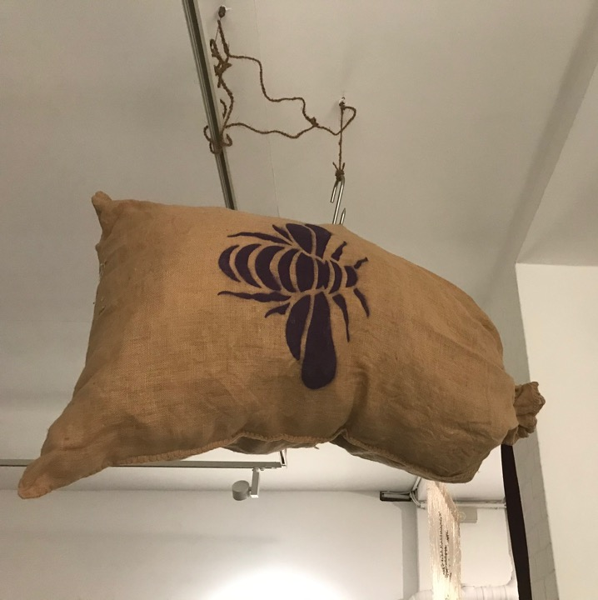

Slide 35
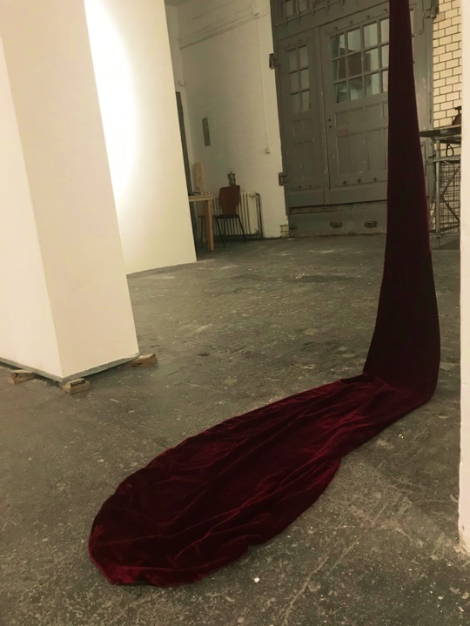

Slide 36
Reinforcements for the Displaced (I-IX)
2013
Authors quoted: Frantz Fanon, Susan Sontag, Adrienne Rich, Adil Jussawalla, Julia Kristeva, Toni Morrison.
Synged machine embroidered organza, hand embroidered tafetta, safety pins.
Size of each panel: 96” x 60” (approx)

Slide 37
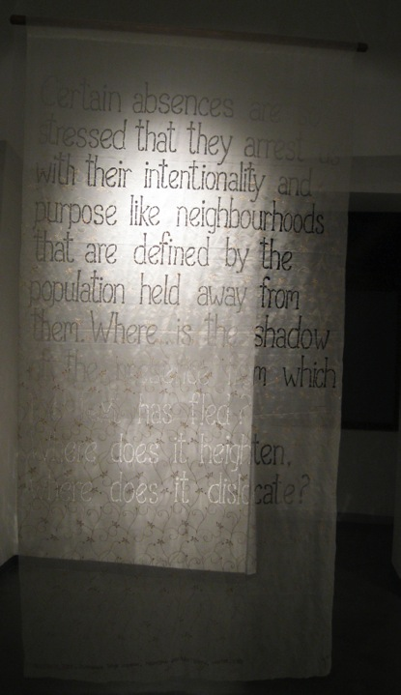
Reinforcements for the Displaced (i)
2013
“Certain absences are so stressed that they arrest us with their intentionality and purpose, like neighborhoods that are defined by the populations held away from them. Where is the shadow of the presence from which the text has fled? Where does it heighten, where does it dislocate?’’
Toni Morrison, ‘Unspeakable Things Unspoken’ Michigan quarterly review, Vol-28, No.1, Winter-1989, Page:11-12

Slide 38
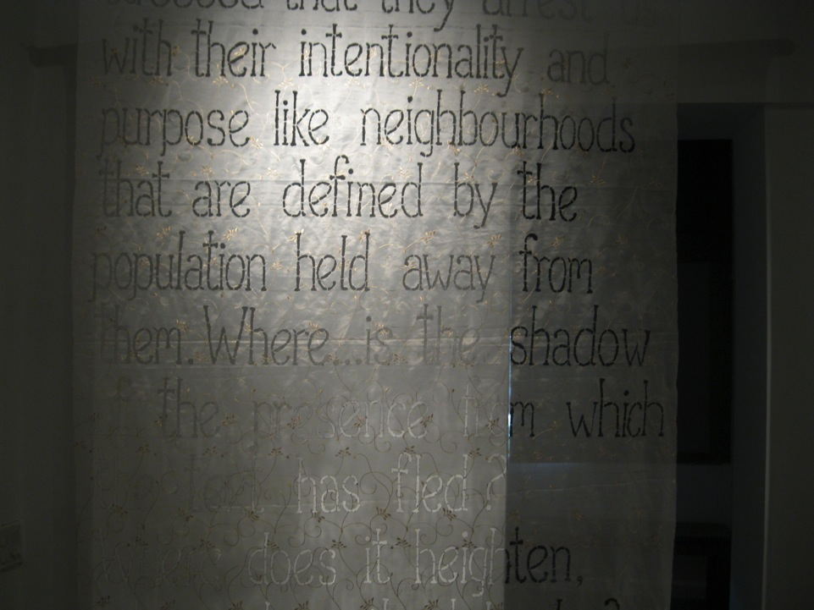

Slide 39
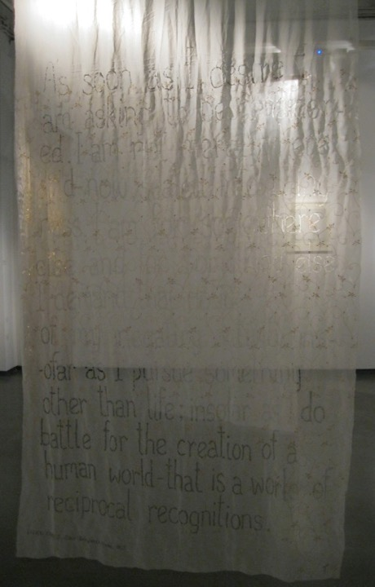
Reinforcements for the Displaced (ii)
2013
“As soon as I Desire, I am asking to be considered. I am not merely here and now, sealed into thingness. I am for somewhere else and for something else. I demand that notice be taken of my negating activity in so far as I do battle for the creation of a human world of reciprocal recognitions.”
-Frantz Fanon; Black Skin, White Masks.

Slide 40
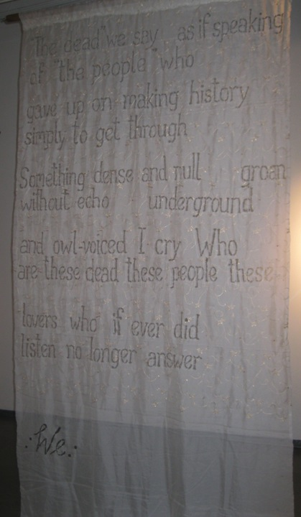
Reinforcements for the Displaced (iii) 2013
“ "The dead" we say as if speaking of "the people" who gave up on making history simply to get through Something dense and null groan without echo underground and owl-voiced I cry Who are these dead these people these lovers who if ever did listen no longer answer : We : ”
-Adrienne Rich; Tonight No Poetry will Serve. 2007-2010, Page 50

Slide 41
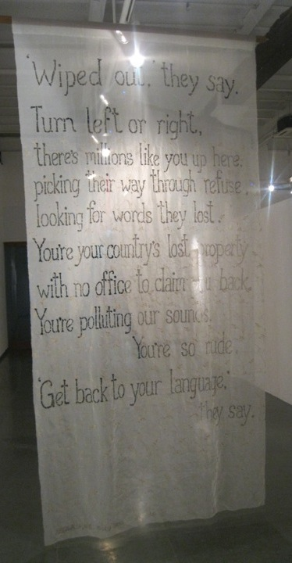
Reinforcements for the Displaced (iv) 2013
“ ‘Wiped Out,’ they say,
Turn left or right,
There’s millions like you up here,
picking their way through refuse,
looking for words they lost.
You’re your country’s lost property
with no office to claim you back.
You’re polluting our sounds, You’re so rude.
‘Get back to your language’, they say.”
-Adil Jussawalla; Missing Person (Clearing House, 1976), Page 15.

Slide 42
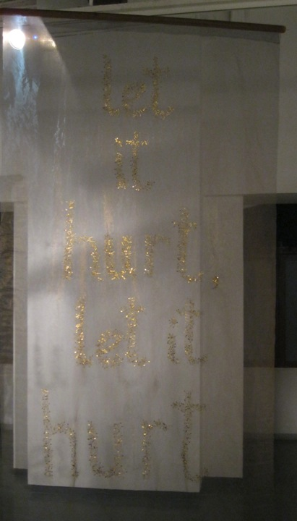
Reinforcements for the Displaced (v)
2013
“Let it hurt, let it hurt”
Susan Sontag;
As Consciousness is Harnessed to the Flesh: Journals and Notebooks, 1964-1980; 2012

Slide 43
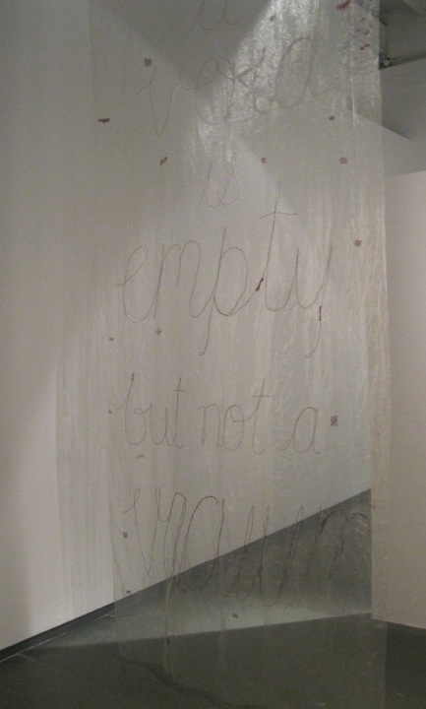
Reinforcements for the Displaced (VIII) 2013
“A void is empty but not a Vacuum.”
-Adrienne Rich; an Atlas of Difficult World. Poems 1988-91, 1991 Page 10

Slide 44
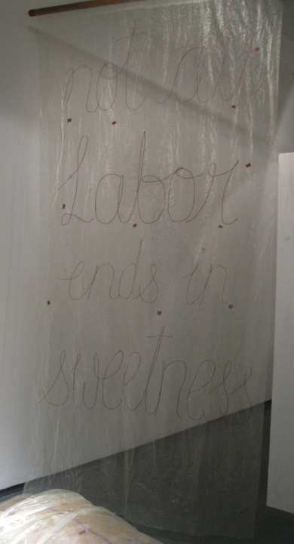
Reinforcements for the Displaced (IX)
2013
“Not all labor ends in Sweetness.”
Adrienne Rich; An Atlas of Difficult World. Poems 1988-91, 1991
Page 10

Slide 45
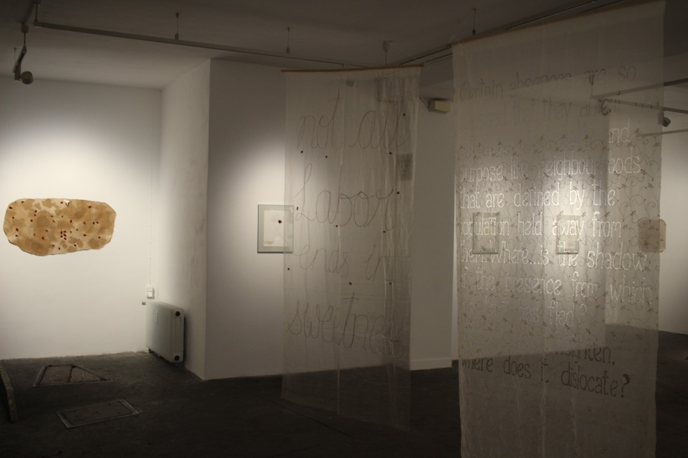

Slide 46
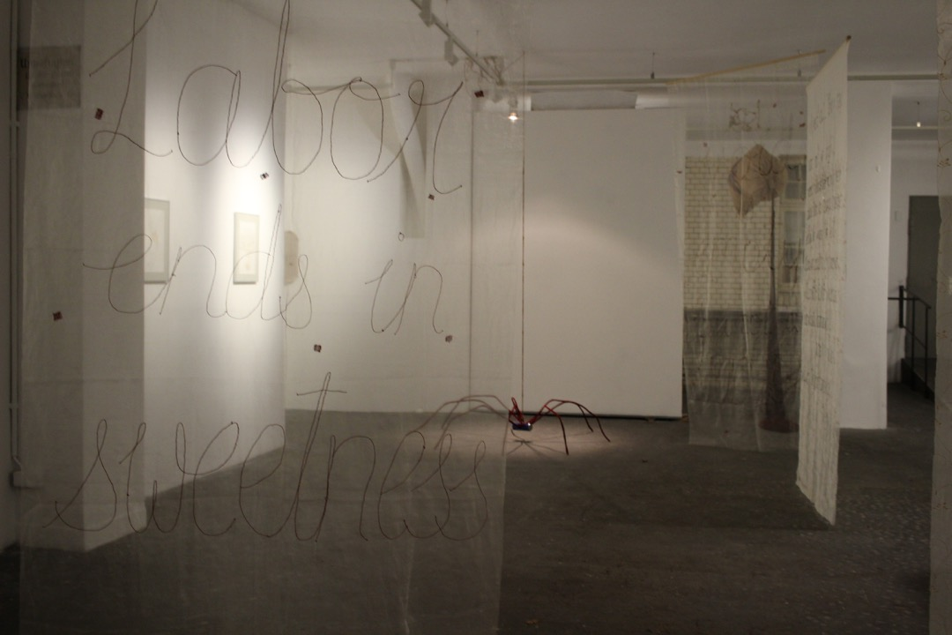

Slide 47
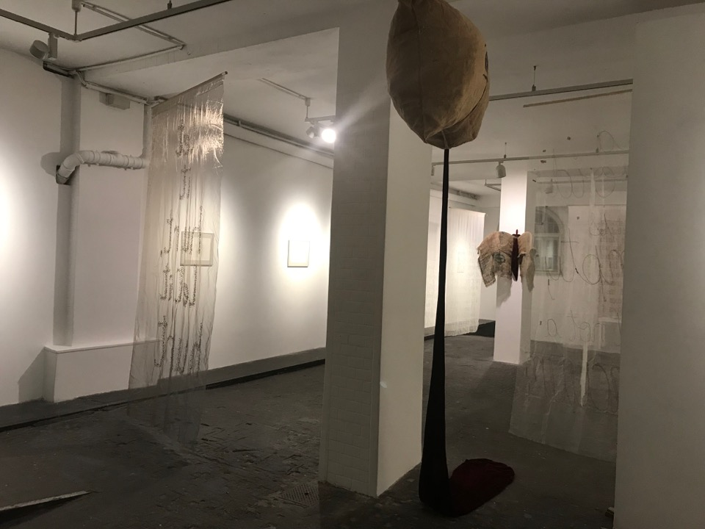

Slide 48
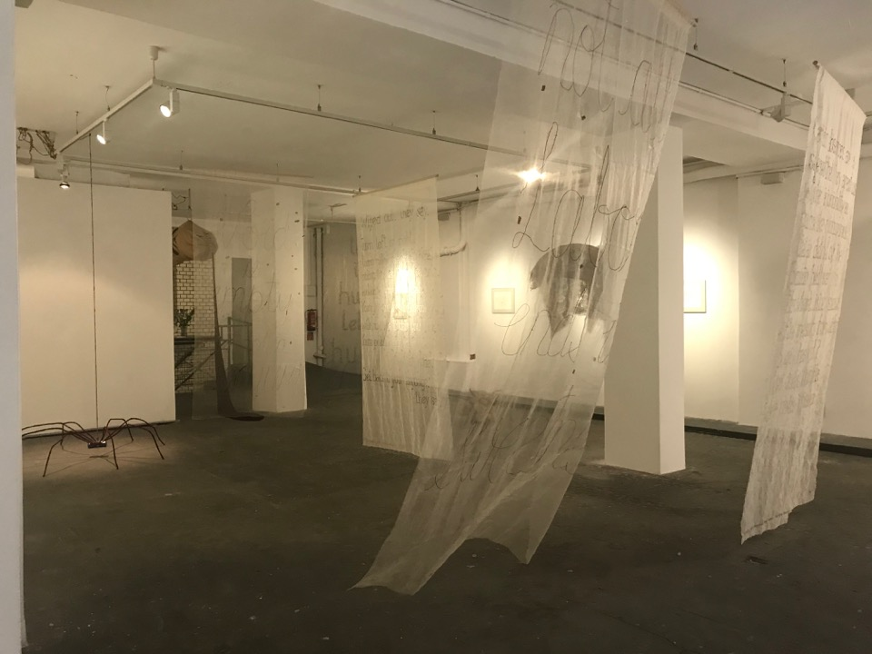

Slide 50
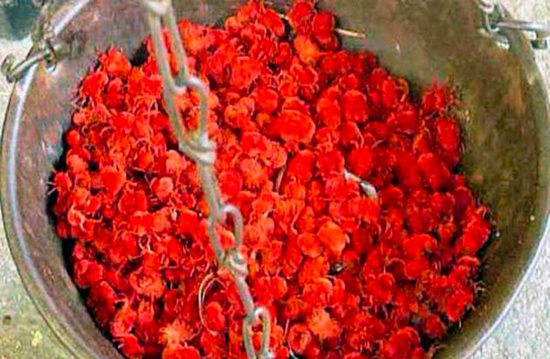
Arudra Purugulu being weighed at a village near Alair in Nalgonda district on Tuesday.–Photo: Singam Venkataramana
Notes:
https://www.thehindu.com/news/national/telangana/rare-breed-of-insects-in-huge-demand/article7349042.ece. Velvet bugs

