Slide 1
Kumari Ranjeeta
2012 -2021

Slide 2
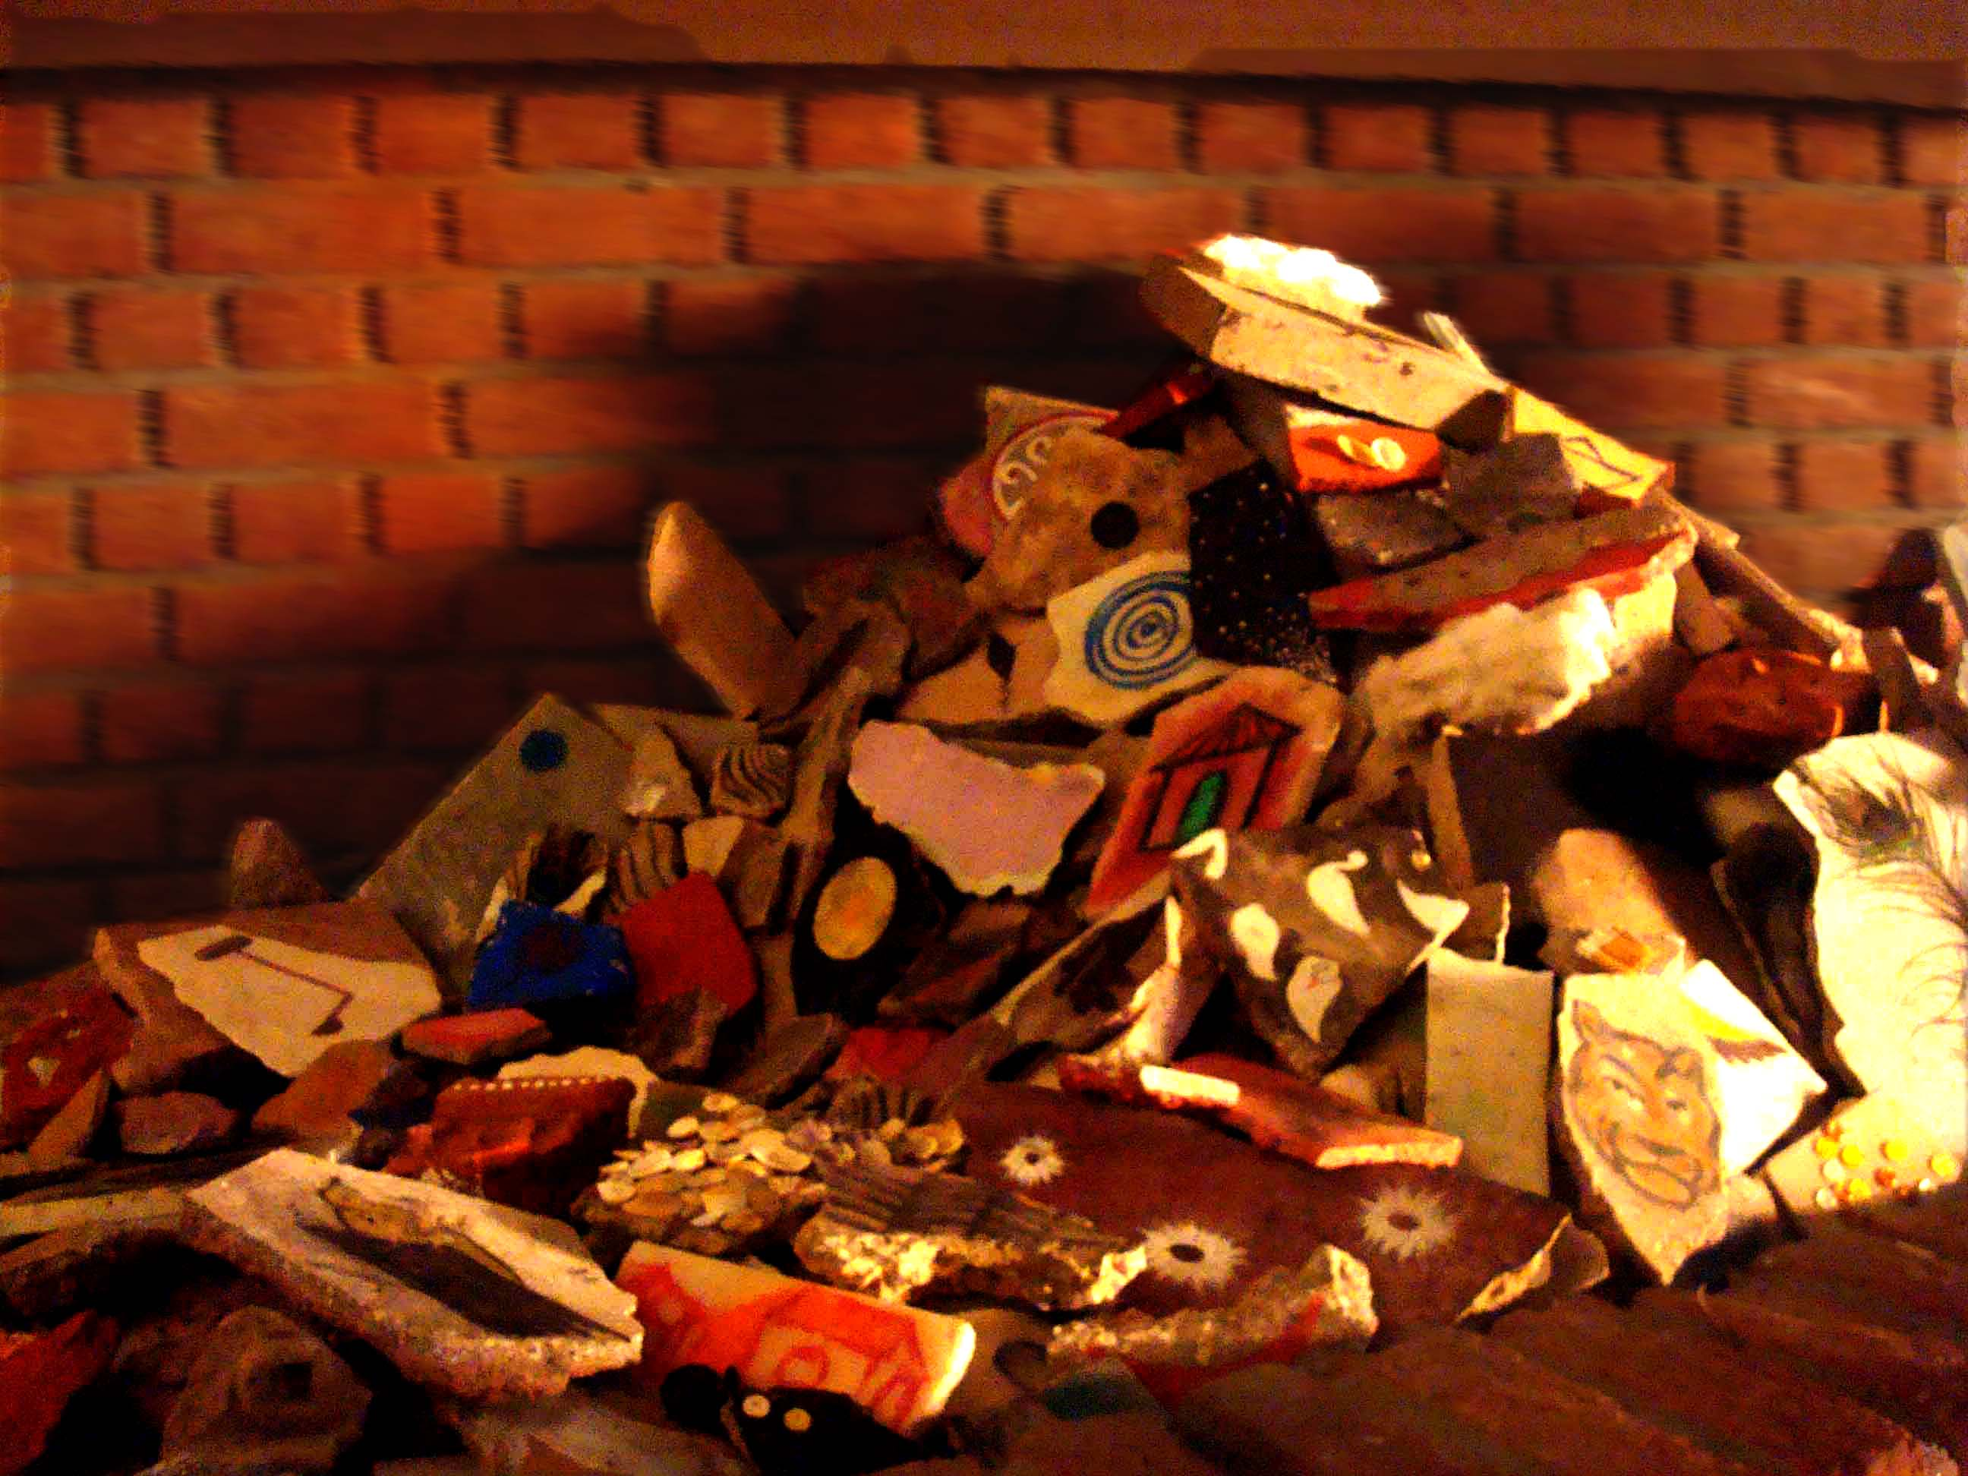
Silence of sorrow, Rubble Mountain (Broken cement houses) Found objects from destroyed site , charcoal and earth color. Exhibited at Devi art foundation Gurgaon 2012.
Notes:
In 2012, I was selected for a residency program at Devi Art Foundation, Gurgaon. I did my work called Silence of Sorrow, where I worked with broken home rubble by collecting from many sites around Delhi.
One morning in Patna, I wake up with the sounds of destruction. Our house and, next door, filled with neighbors and friends, was being broken down. My first thought was of each of the familiar soul who lived within its brick walls. Where would they disappear too. Destruction does not take long to achieve. Using small broken parts of cement house, I painted different types of natural forms and elements of existence by using charcoal and earth colors and. The project explores multifarious images from the world of dreams and nature. I install them in the form of a rubble mountain. I distributed some of these art pieces from my installation among the visitors and encourage conversations on memories loss of a simpler past. The Rubble Mountain was an interactive art work which incorporates installation with painting. How it is related to our culture, life and history. And how we too are face first in the long line of endangered species.

Slide 3
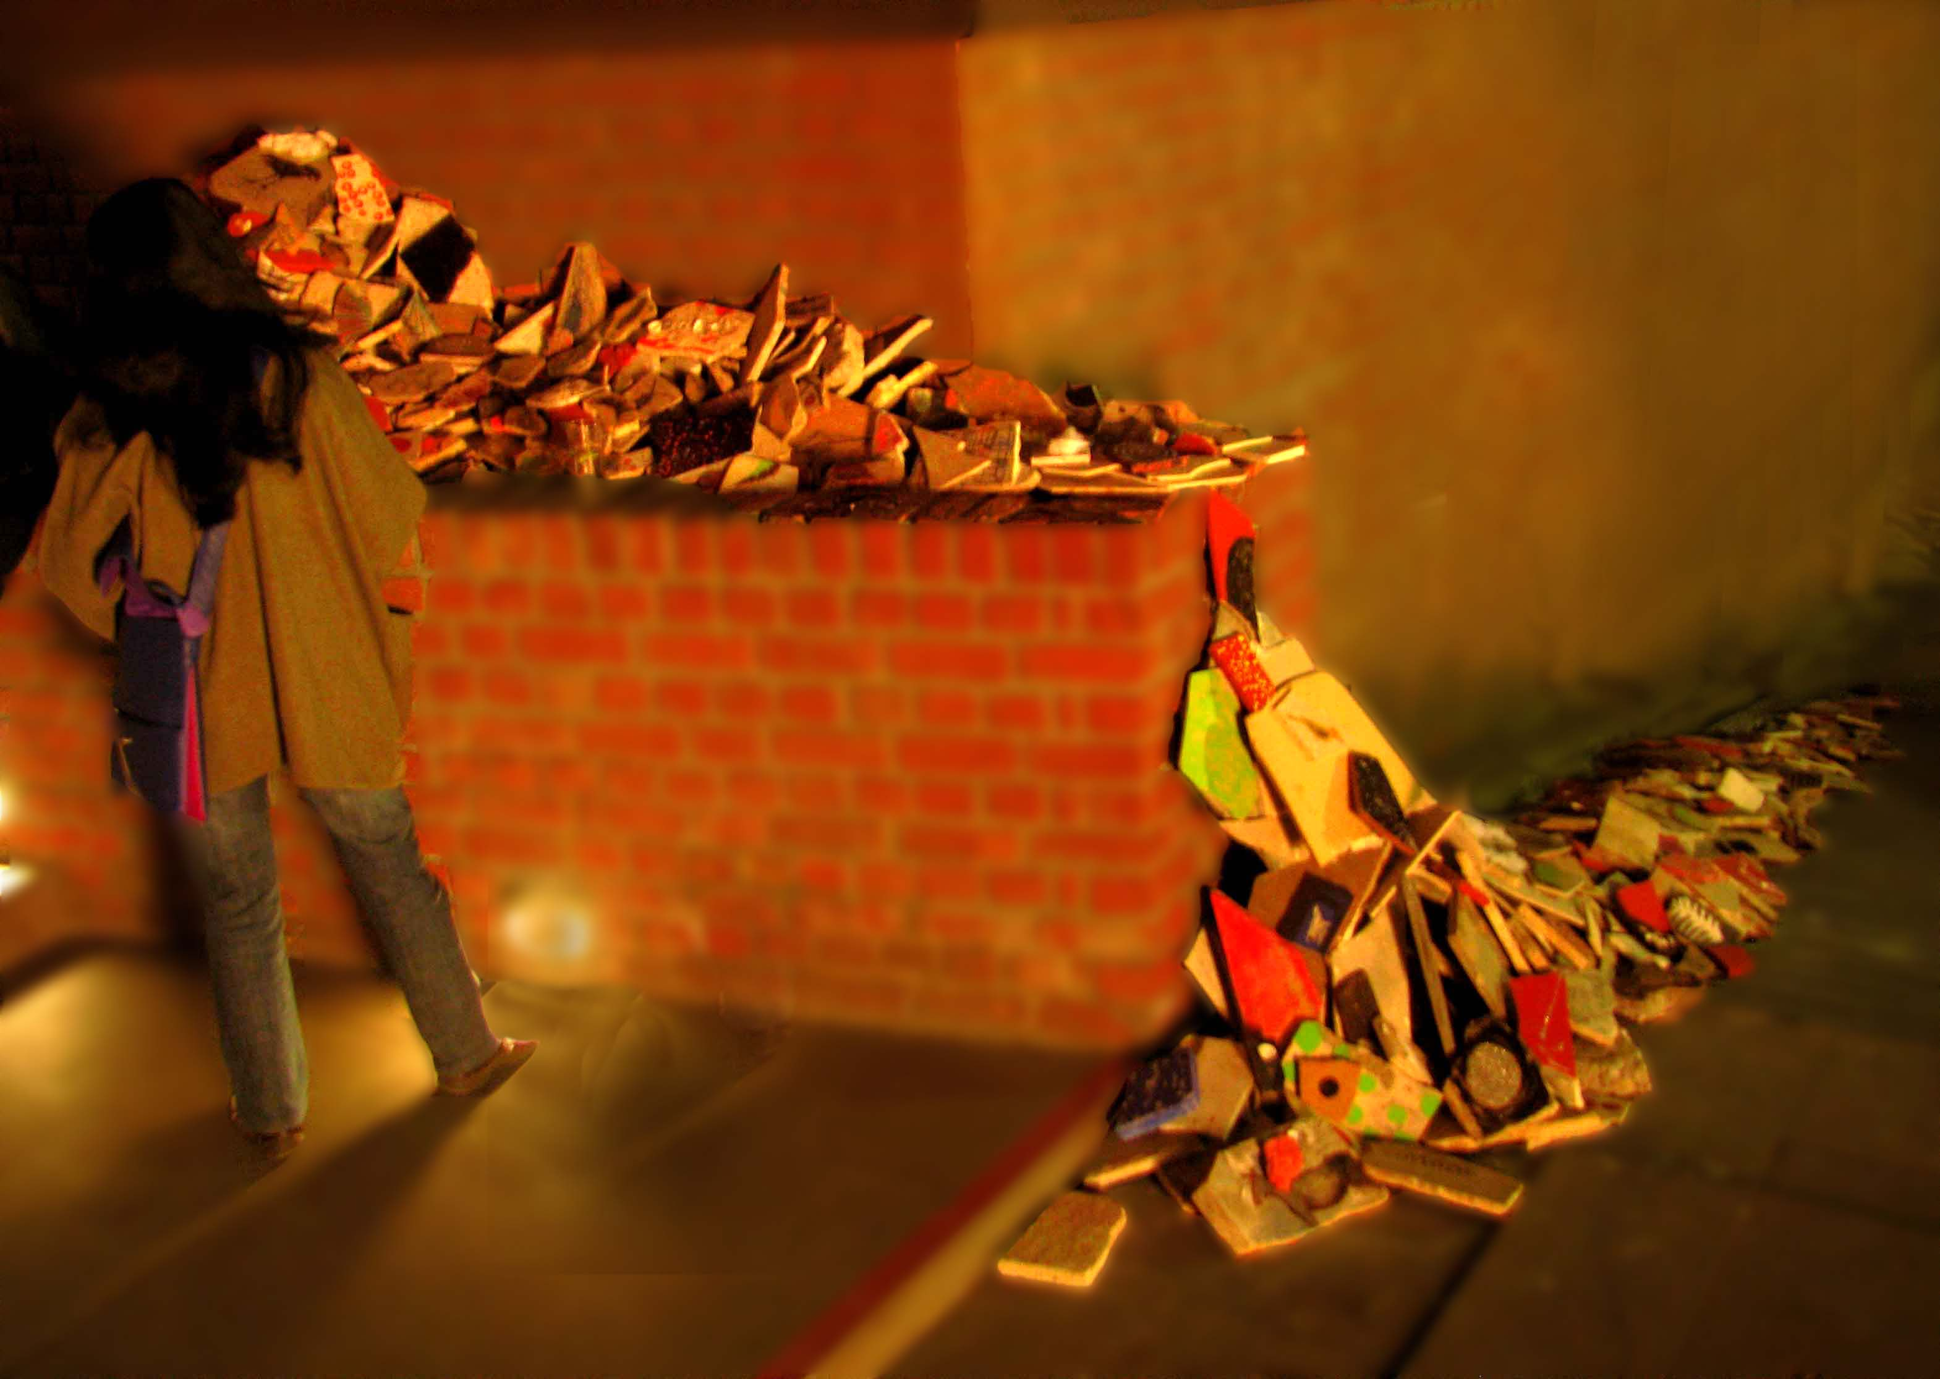

Slide 4
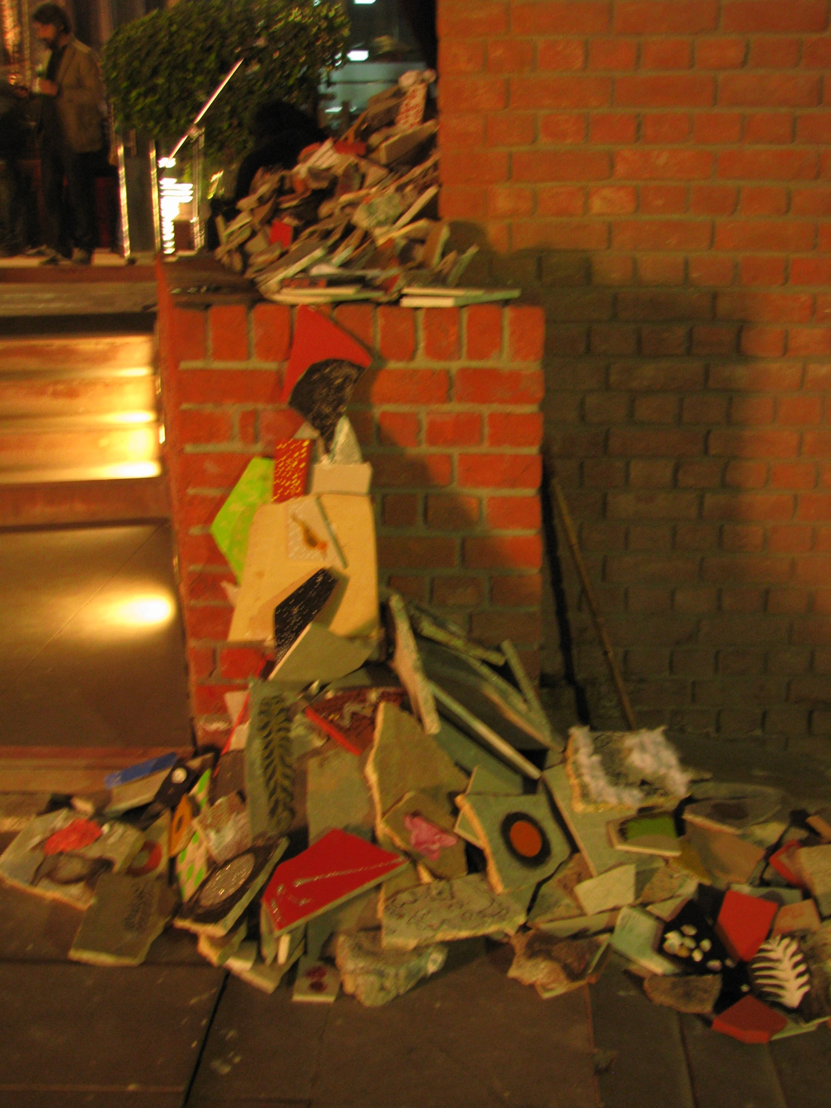

Slide 5
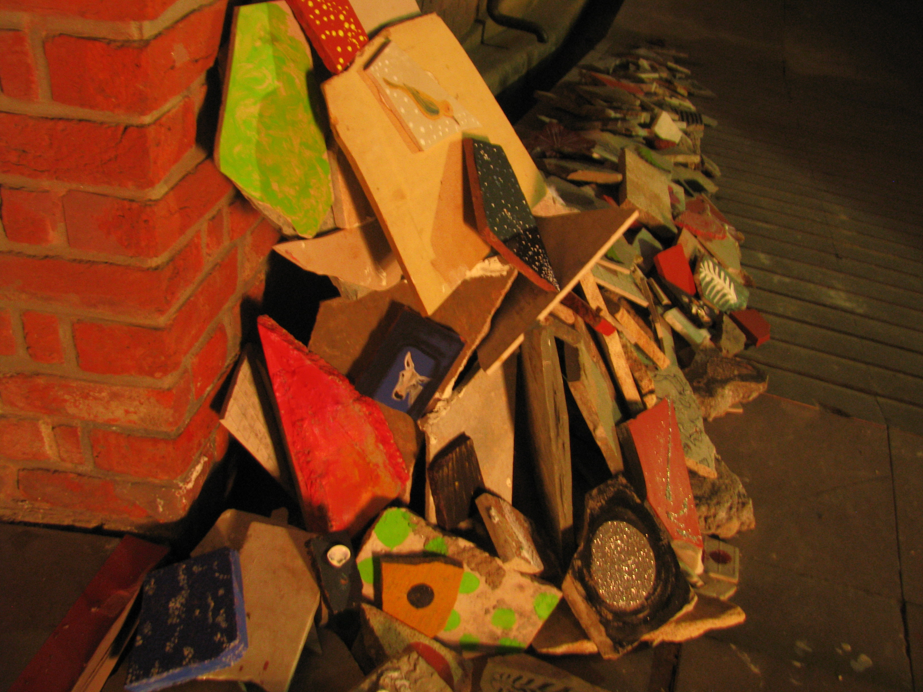

Slide 6
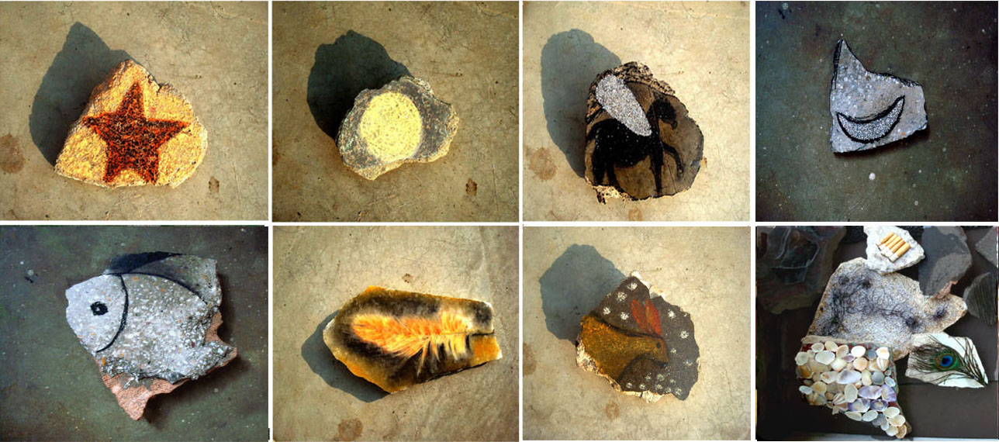

Slide 7
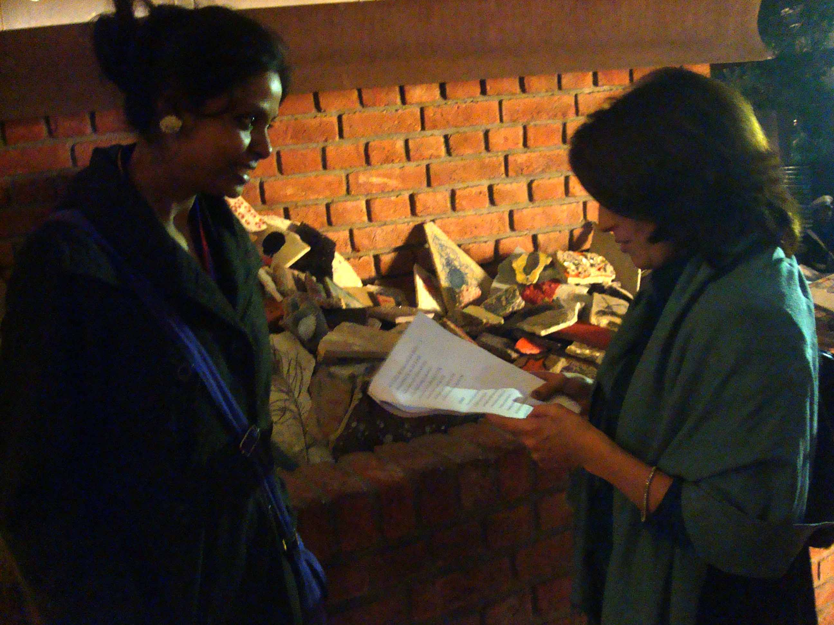

Slide 8
Farming of Fundamental

Slide 9
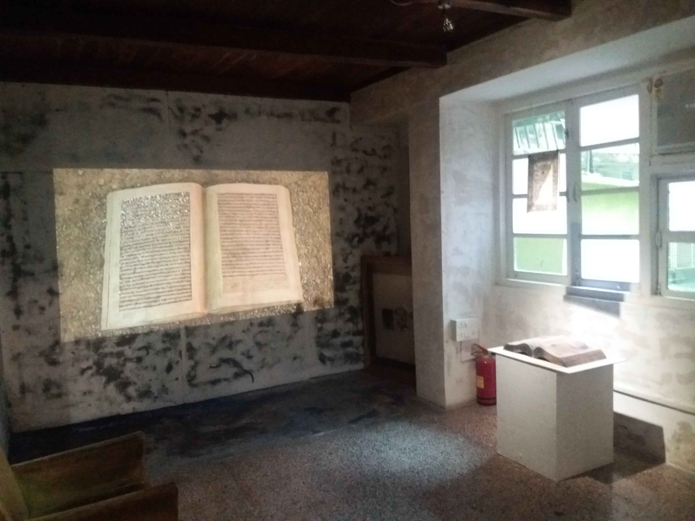
FARMING OF FUNDAMENTAL Left- Clay book, Mustard seed, L 48 x W 30 x H 9 cm, with five minute eleven seconds, Stop Motion Video Click here to watch- https://vimeo.com/163128908 Right- Terracotta book and Preamble of constitution of India, Print on Matt Fiber paper, painted in watercolor, size L 8 X W 10 inches, there is a video file attached. 2016

Slide 10
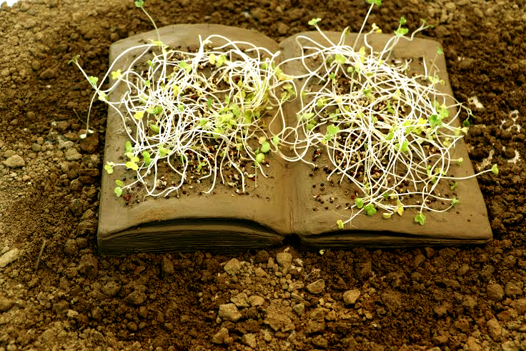
Notes:
To create book first I am inspired by the preamble of constitution of India. I planted mustard seeds which referring to the farmers and people from margin and I have seen most of the people from Bihar and those from working classes all over India use mustard for many purposes like as oil and for body lotion. My mother has always been making oil with mustard in my village, Mokama. As I belong to a working class family, I realized that mustard represents people who have been fighting for long for their rights leading to many revolutions. At the same time constitution of India, authored primarily by Dr. B. R. Ambedkar. The public statues of Ambedkar always show him as carrying it in his hand and that is a hope for the marginalized people and it inspires me when that the first page of constitution mentions, justice, equality, liberty, and fraternity. It‟s all about rights. when I read these words I deeply feel something growing inside me like plants rights to grow. For me this is a beautiful poem about the dream of a country which is dead in the current scenario and it does not exist at the ground level. I have planted mustard seed as words of preamble speaks. So I am seeing this book as alive and green in the since of it is working for the people who disserves it but unfortunately in reality it is not, that is why at the end my story, I transform the green alive clay book into a terracotta‟s broken sculpture which is represented as an object kept into the museum.

Slide 11
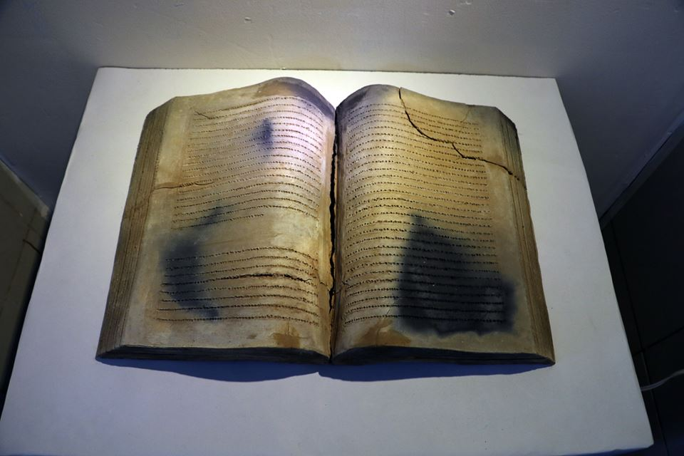

Slide 12
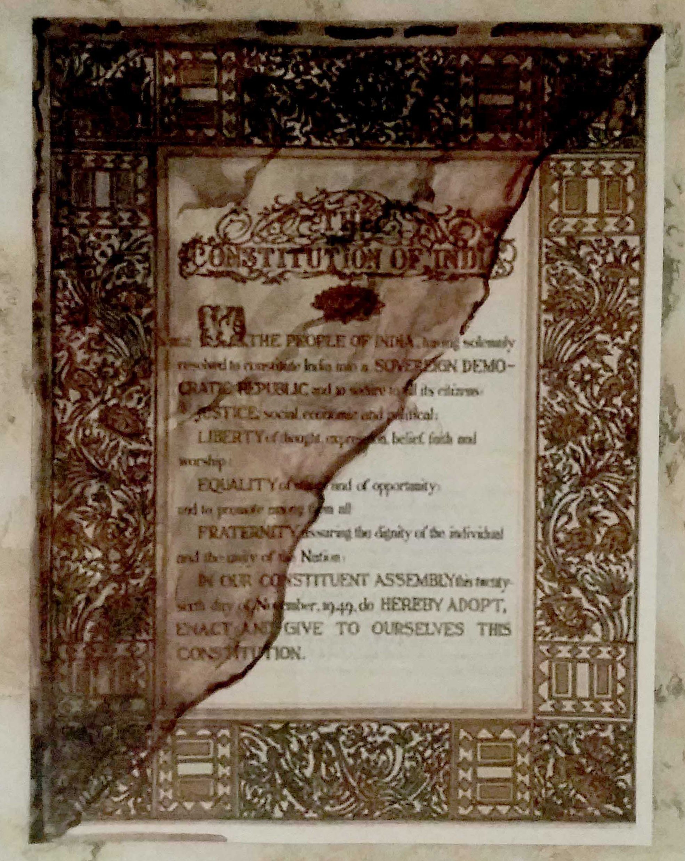

Slide 13
Donkey series

Slide 14
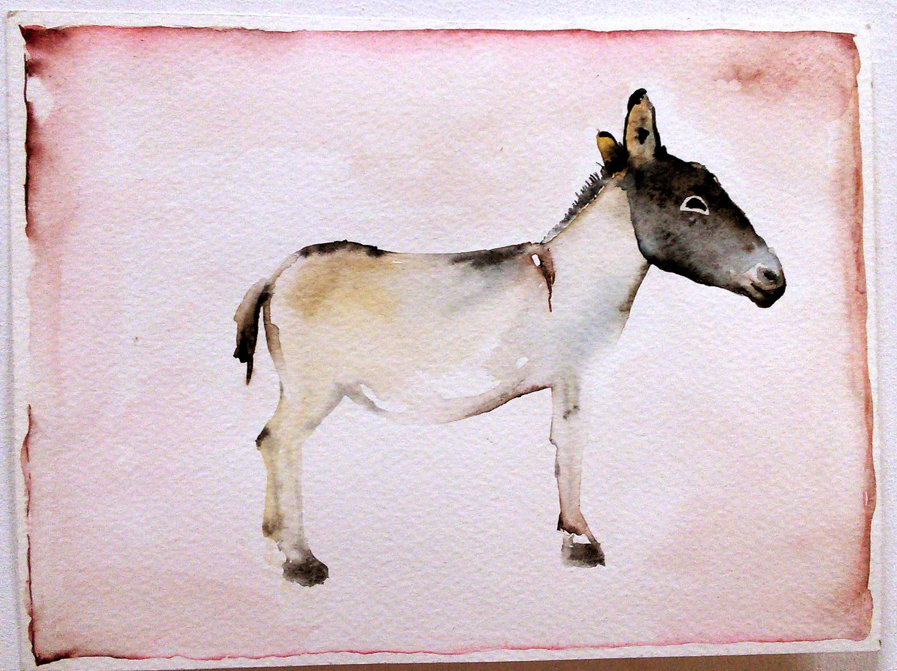
Watercolor on paper, size 4 x 6 inch, 2014

Slide 15
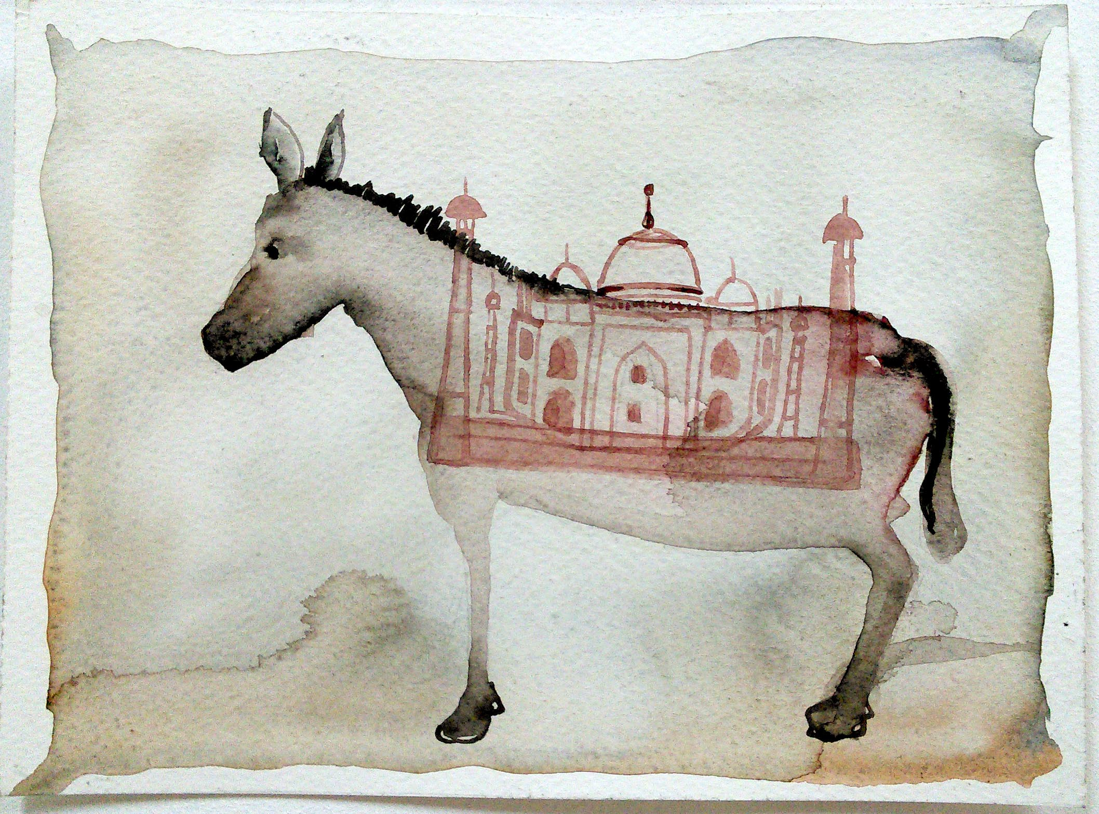
Watercolor on paper, size 4 x 6 inch , 2016.

Slide 16
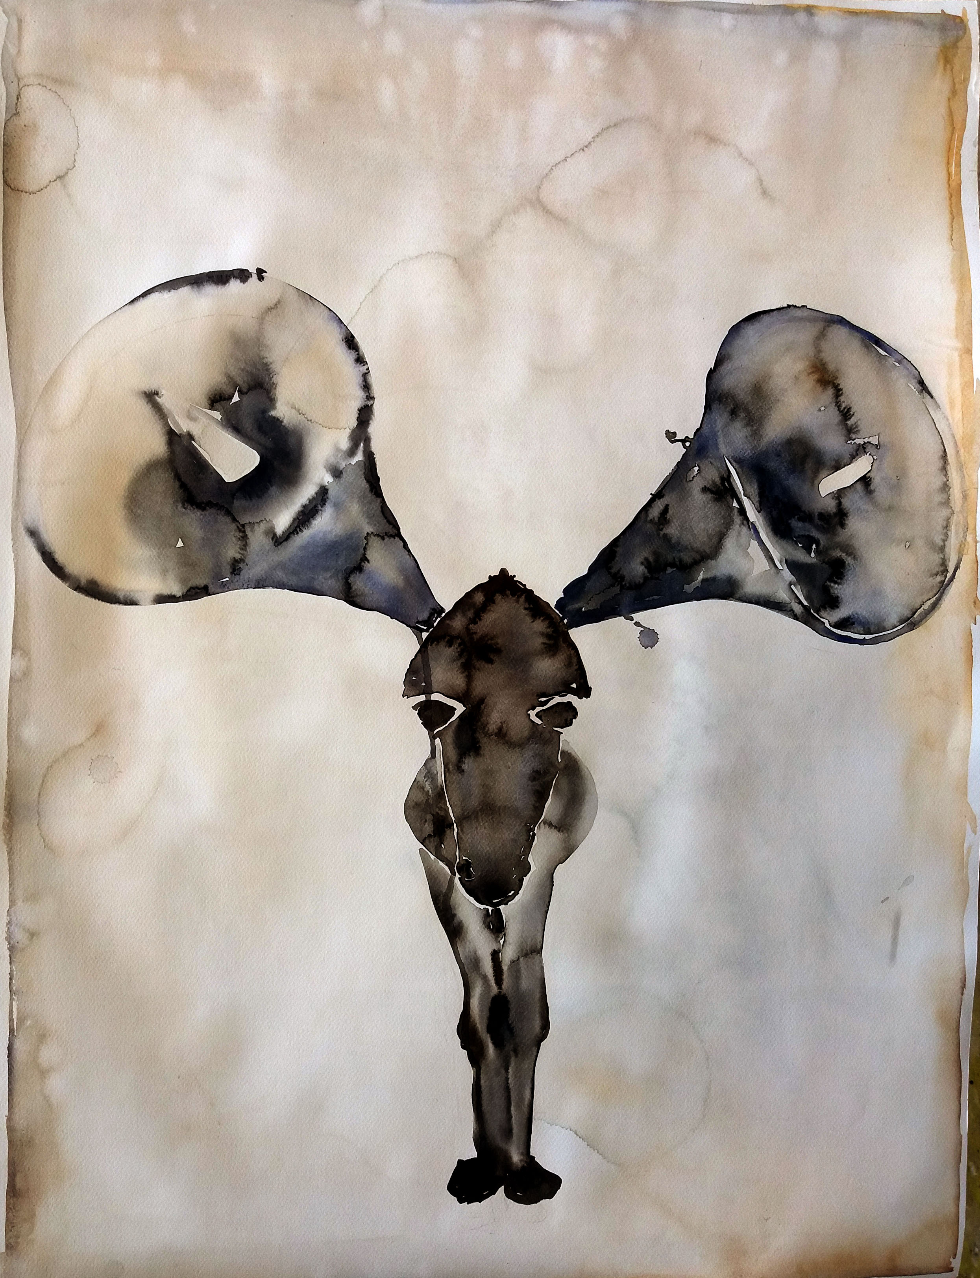
Watercolor on paper,
Size 22 x 29 inch, 2016

Slide 17
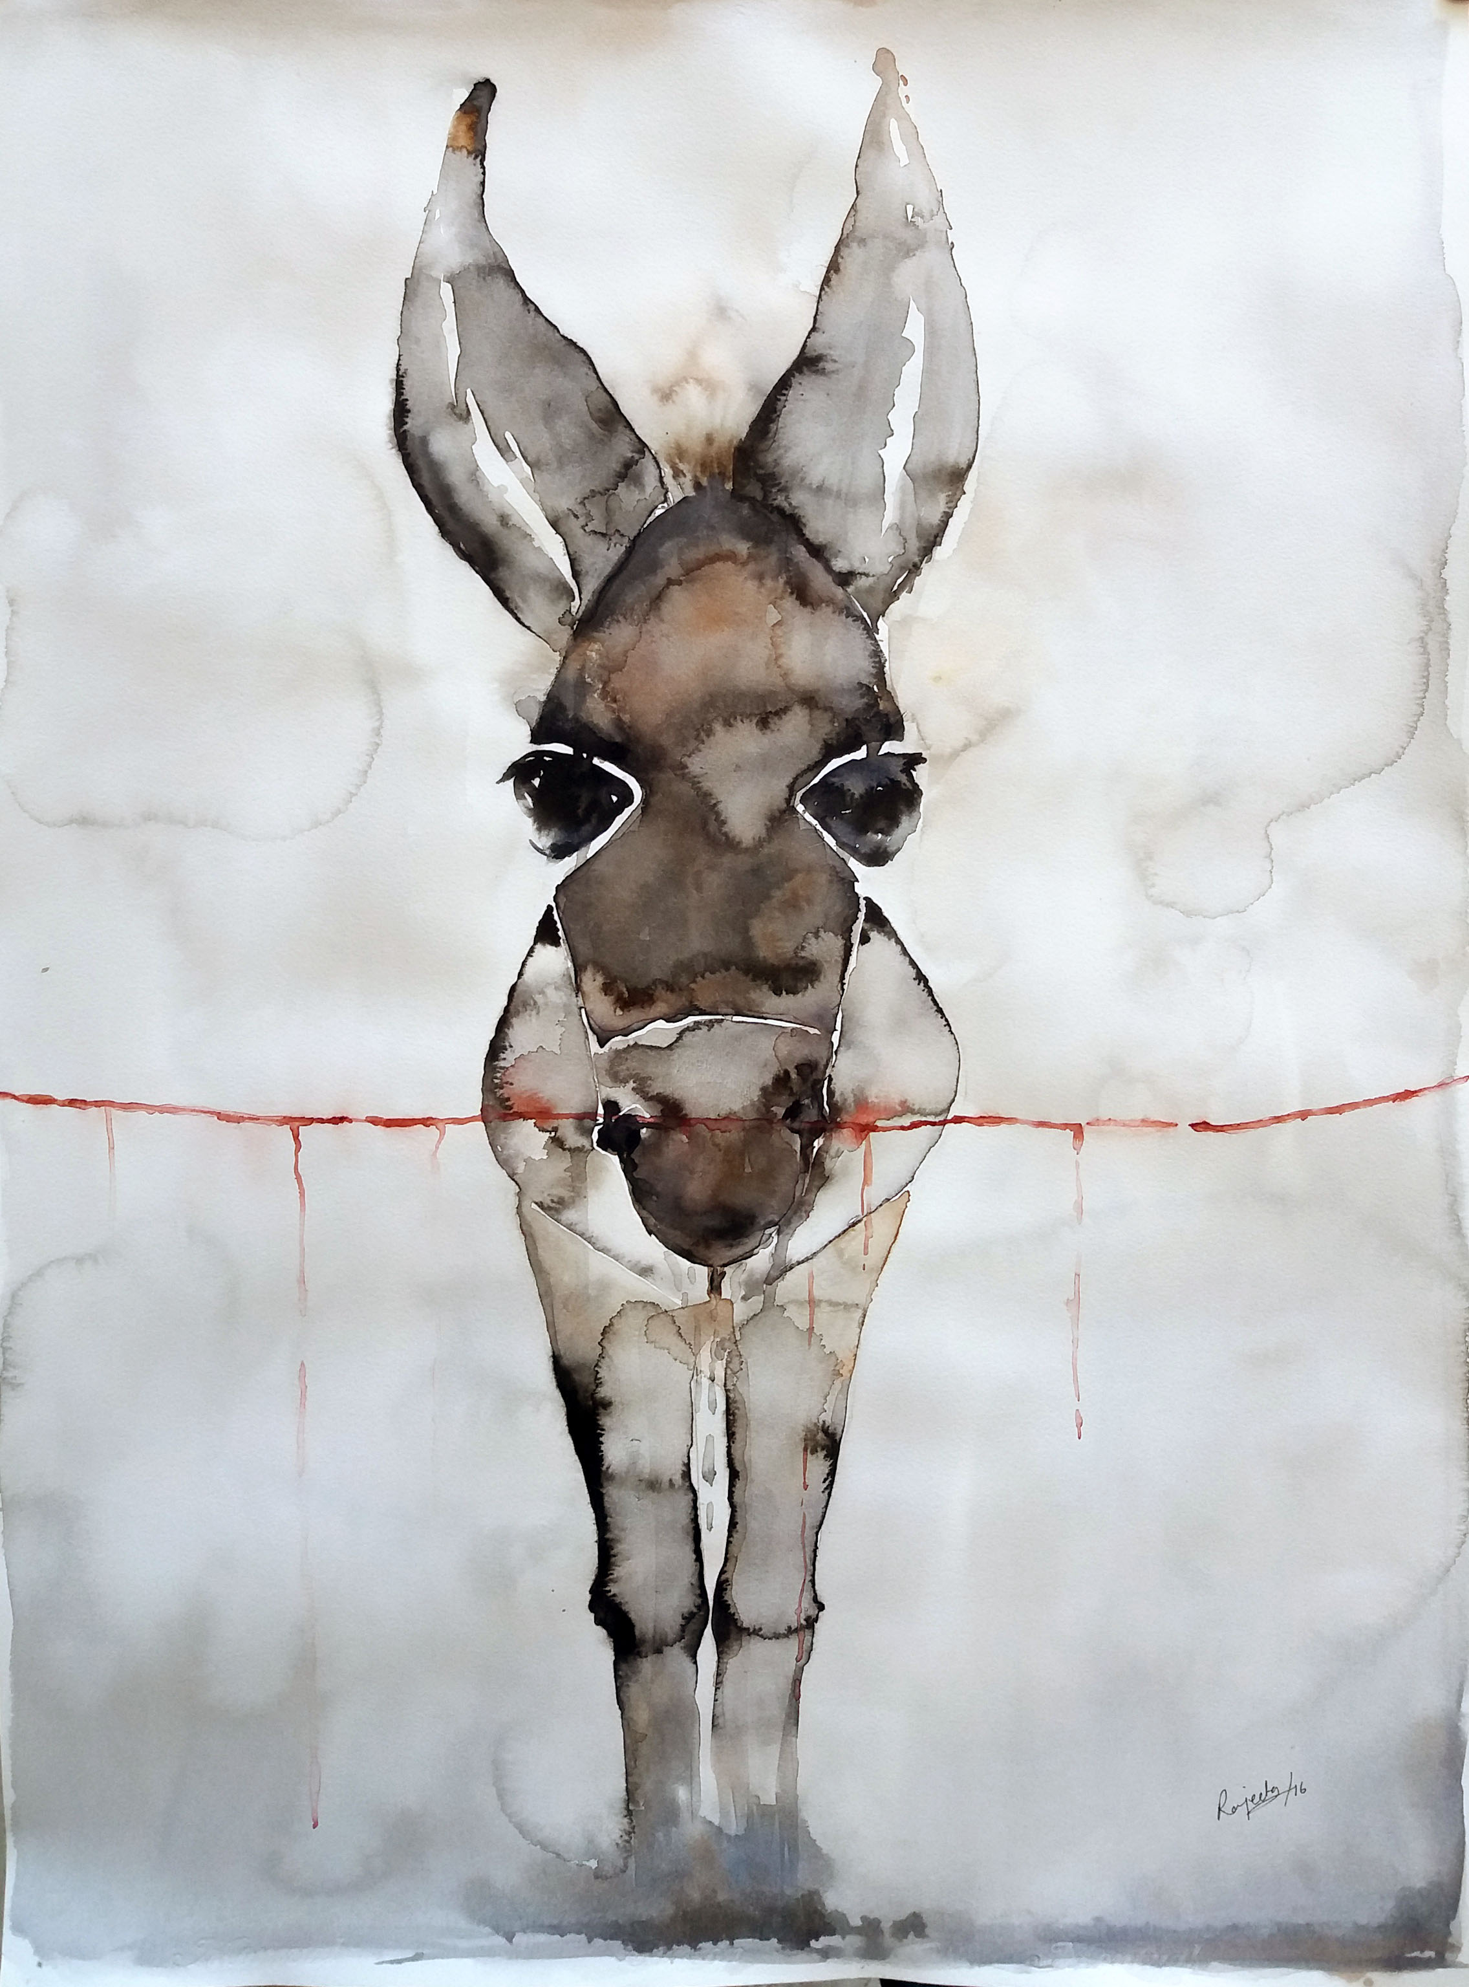
Watercolor on paper,
Size 22 x 29 inch,
2016.

Slide 18
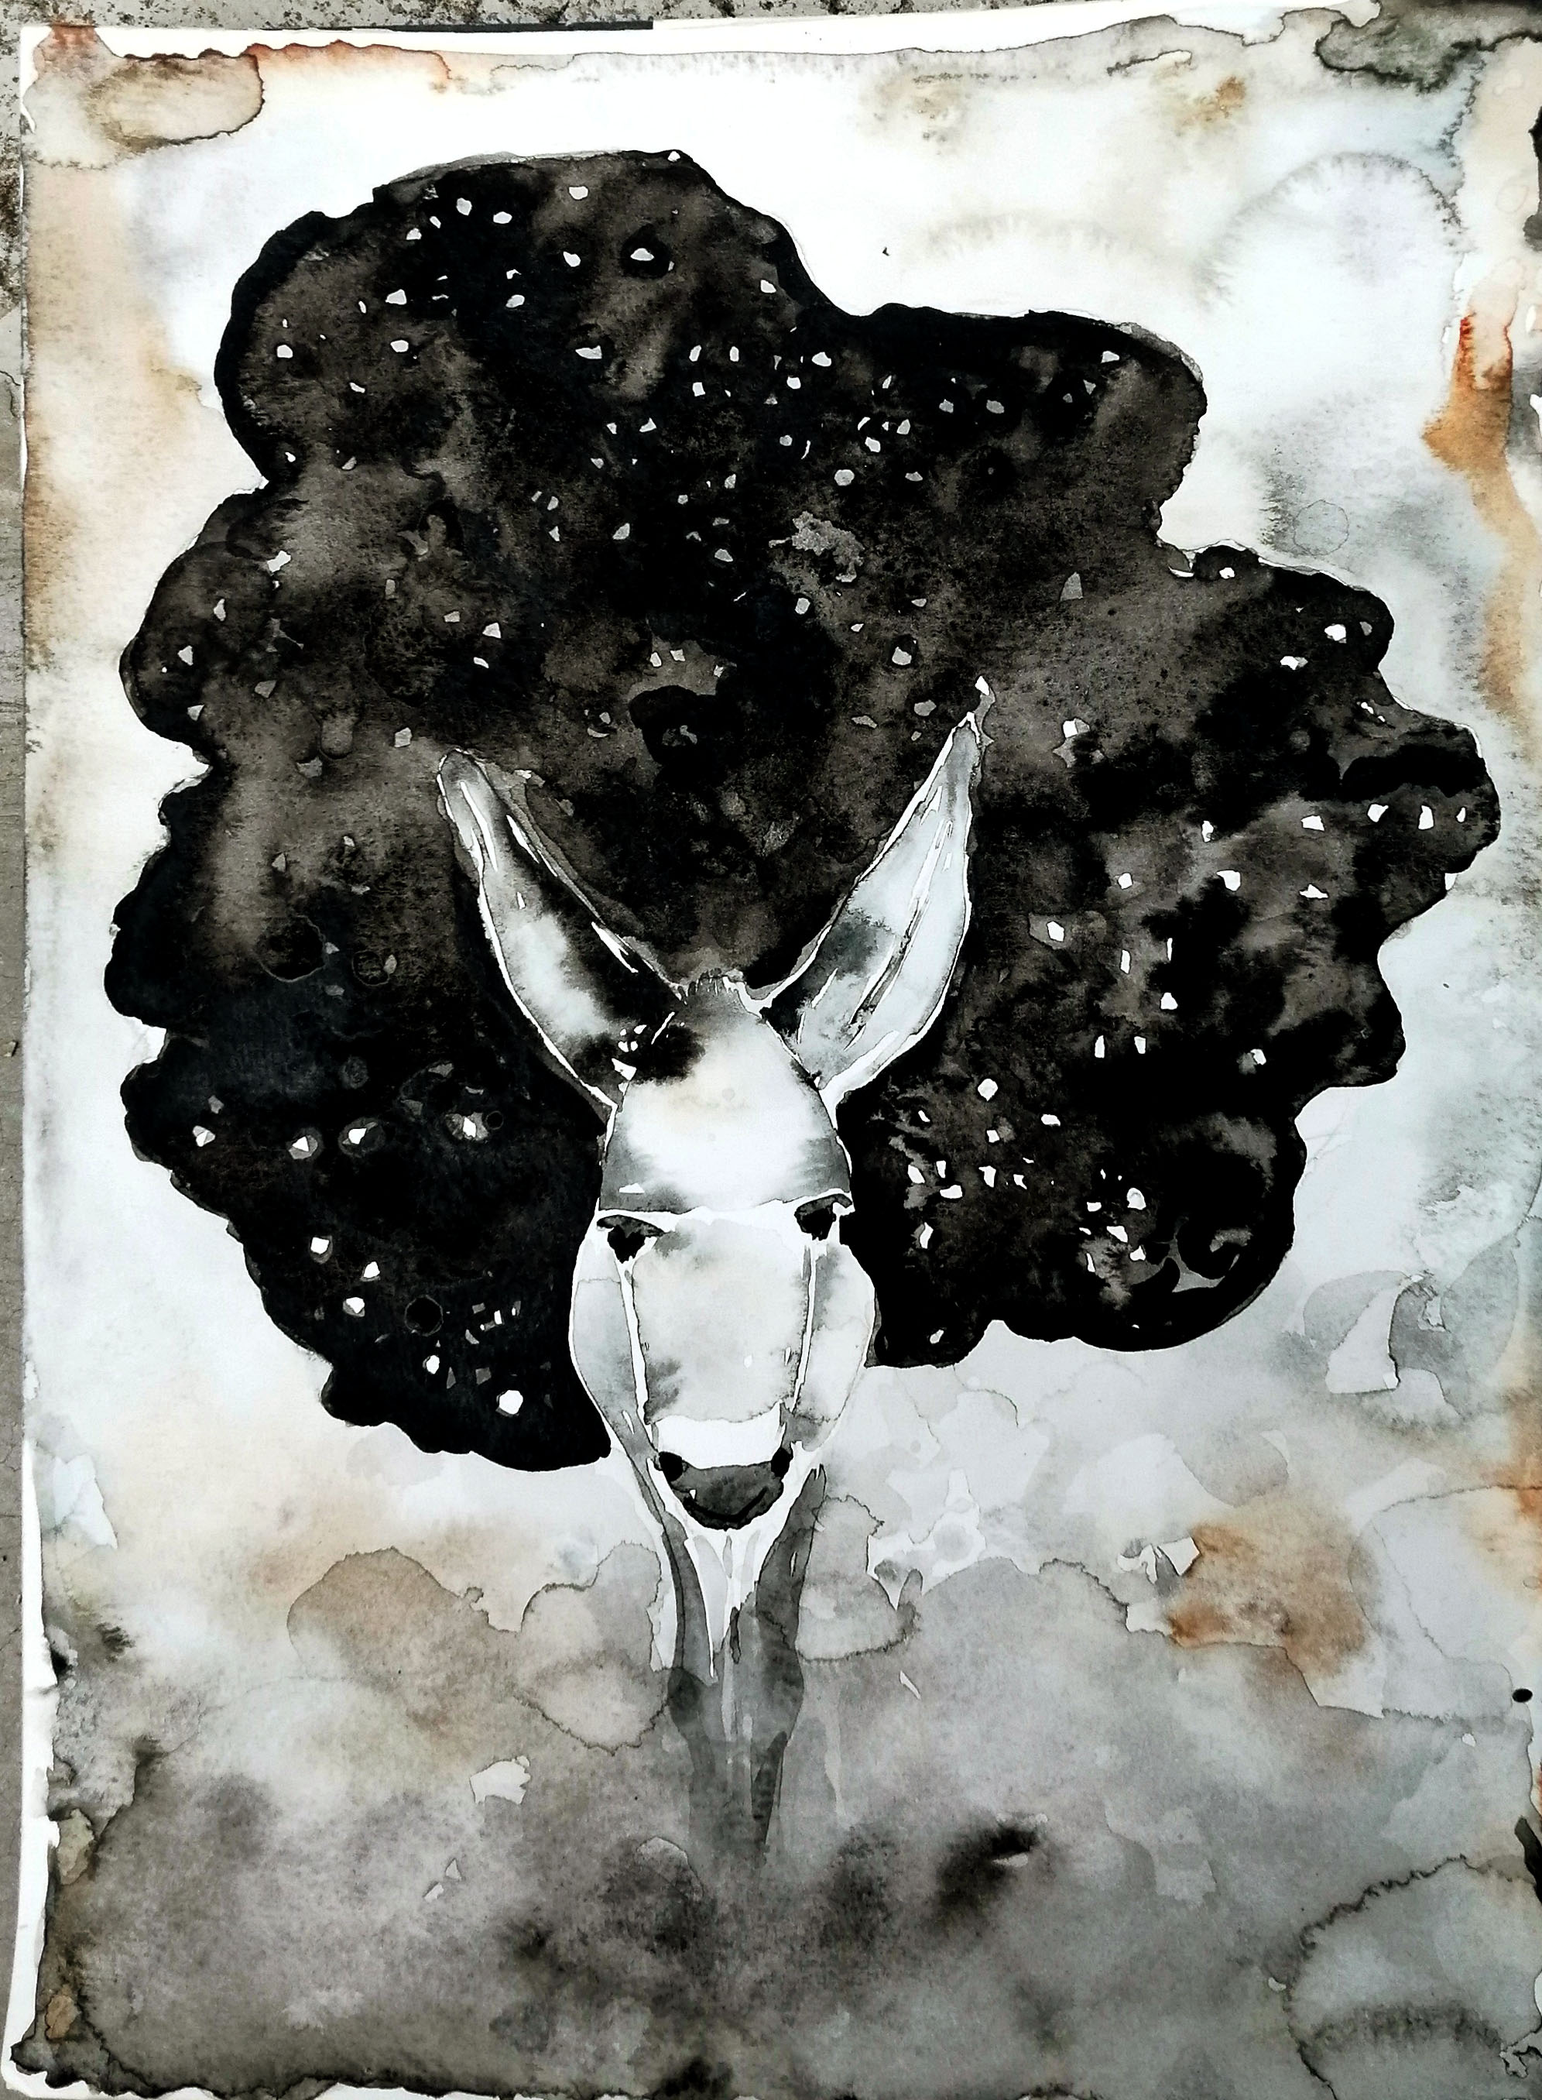
Black cloud, Watercolor on paper, size 9 x 12 inch, 2020.

Slide 19
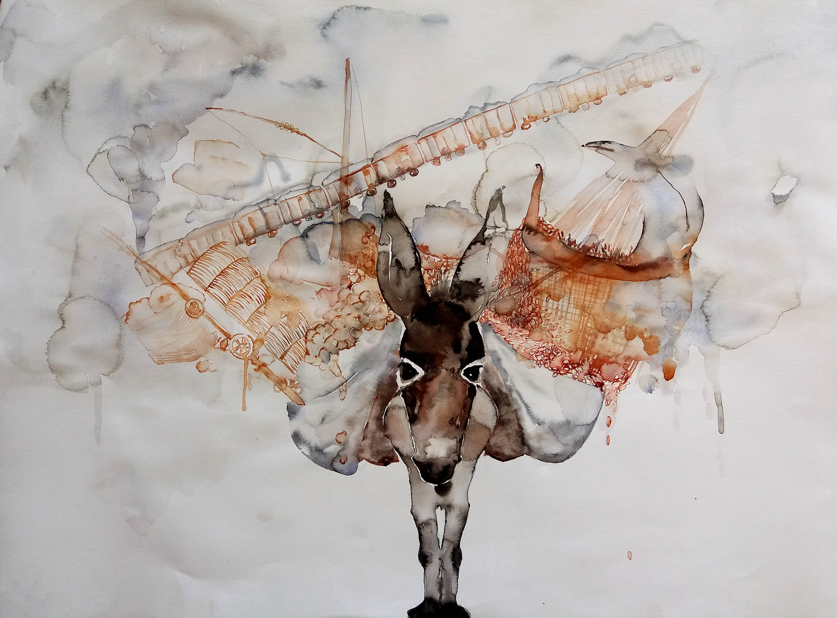
Watercolor on paper, size 22 x 29 inch, 2017.
Notes:
I think Donkey is a very beautiful animal who is always seen with the labour class people, hardworking and innocent in the world. who is up to Cross the line of annihilation. Image of donkey has a most important role in trade history who has been carrying the material for long distance from one country to another country. During the birth of Jesus Christ donkey stands for marry(it is called, donkey stands for women) in a sense it is also a self-portrait with inspiration.

Slide 20
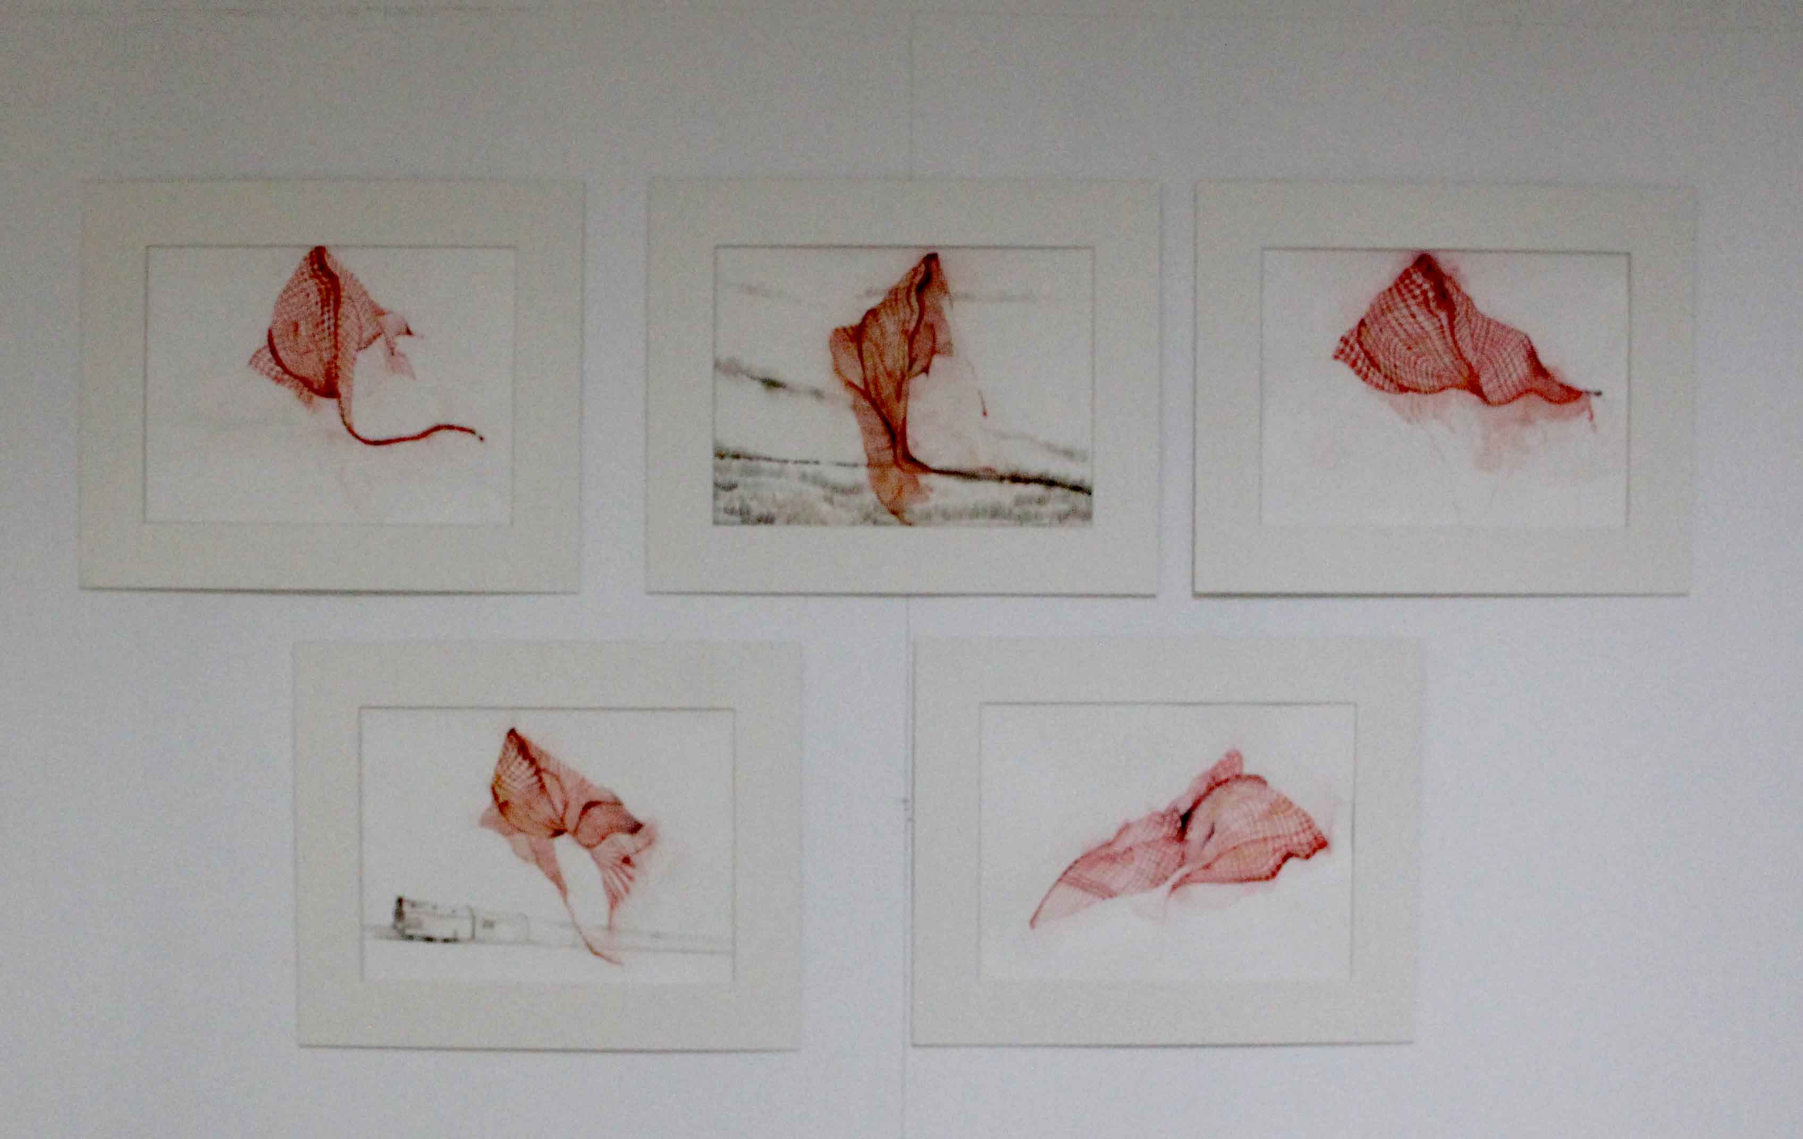
AFTERNOON, water color on paper, L 9 x W 12 inches each, (series of 5 work) 2016.

Slide 21
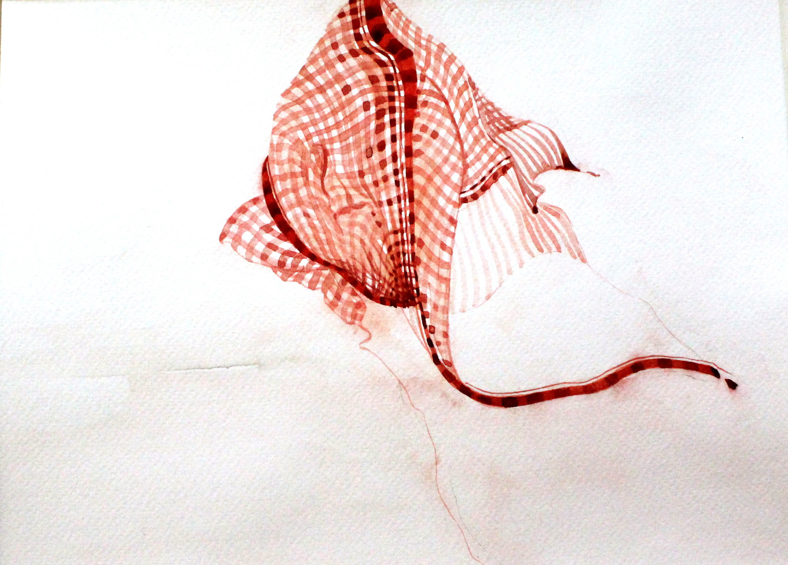

Slide 22
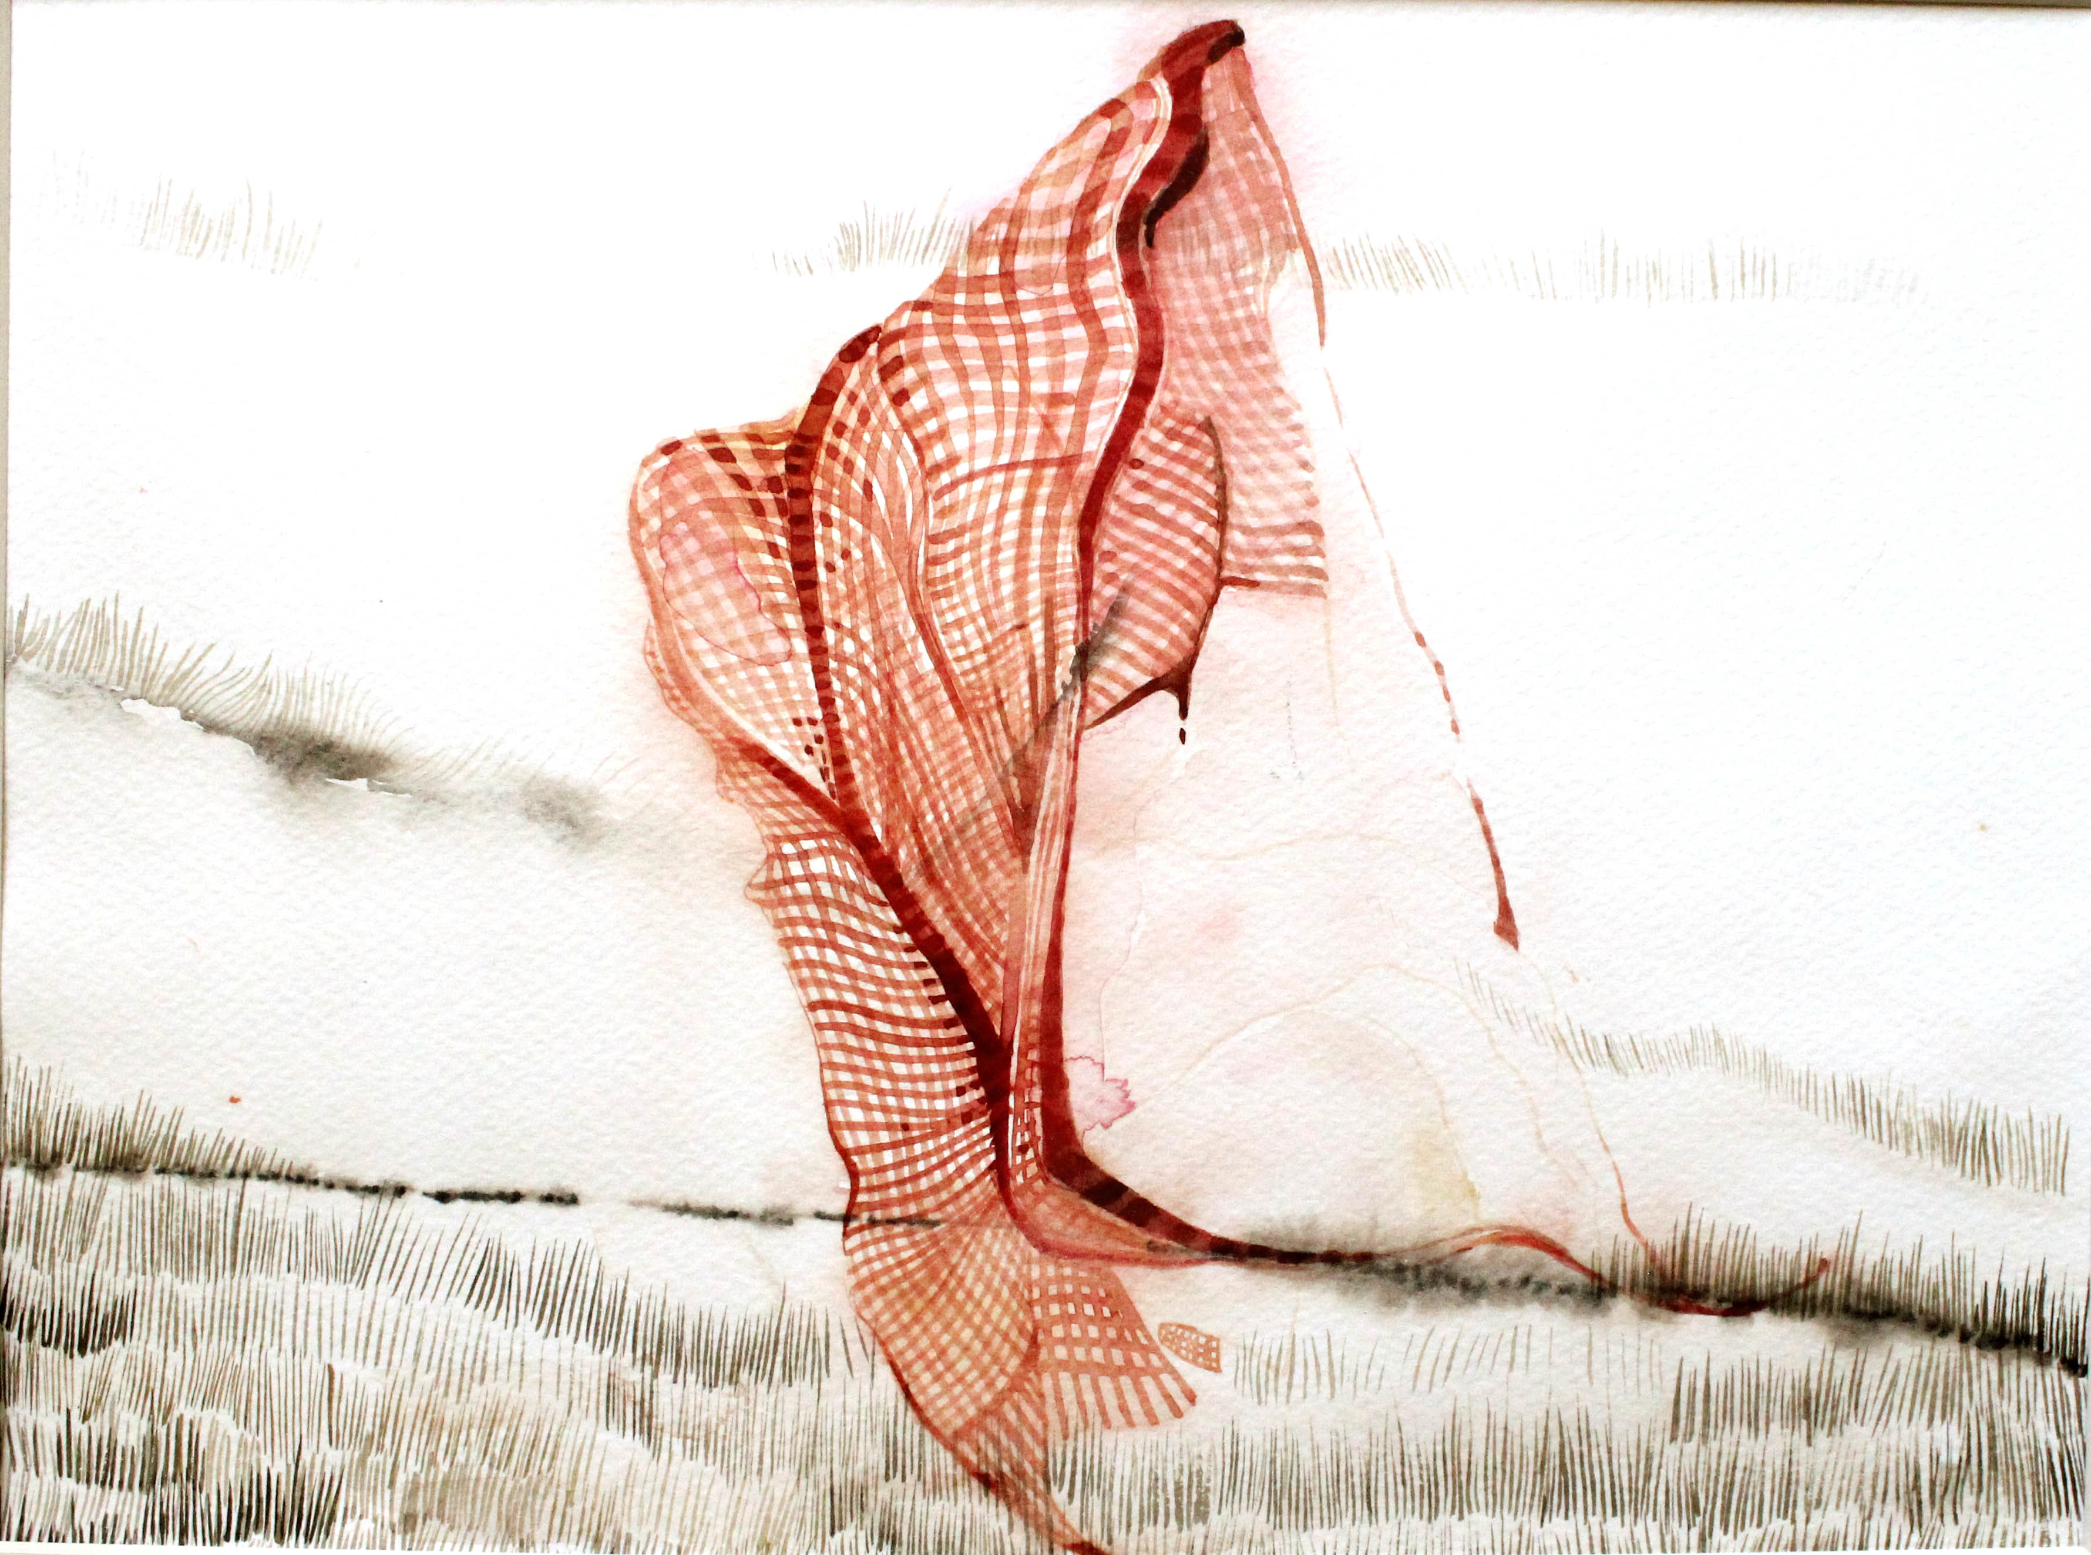
Notes:
I found this piece of cloth at the workers' site which I clicked a few pictures of alongside some other objects and tools. I painted this particular image as it really interested me; the subtle lines drawn upon it give it the look of an abstract painting indicative of the myriad perspectives regarding the issues faced by the workers. This image thus became very significant to me as a metaphor of the silence which speaks a million words. The cloth sometimes looks like a flag. The cloth is also symbolic of the identity of the workers as it is tied by them on the head, the shoulders, the hips, and is also used by them for various purposes; the cloth (Gamcha) is an icon of the existence of the workers.

Slide 23
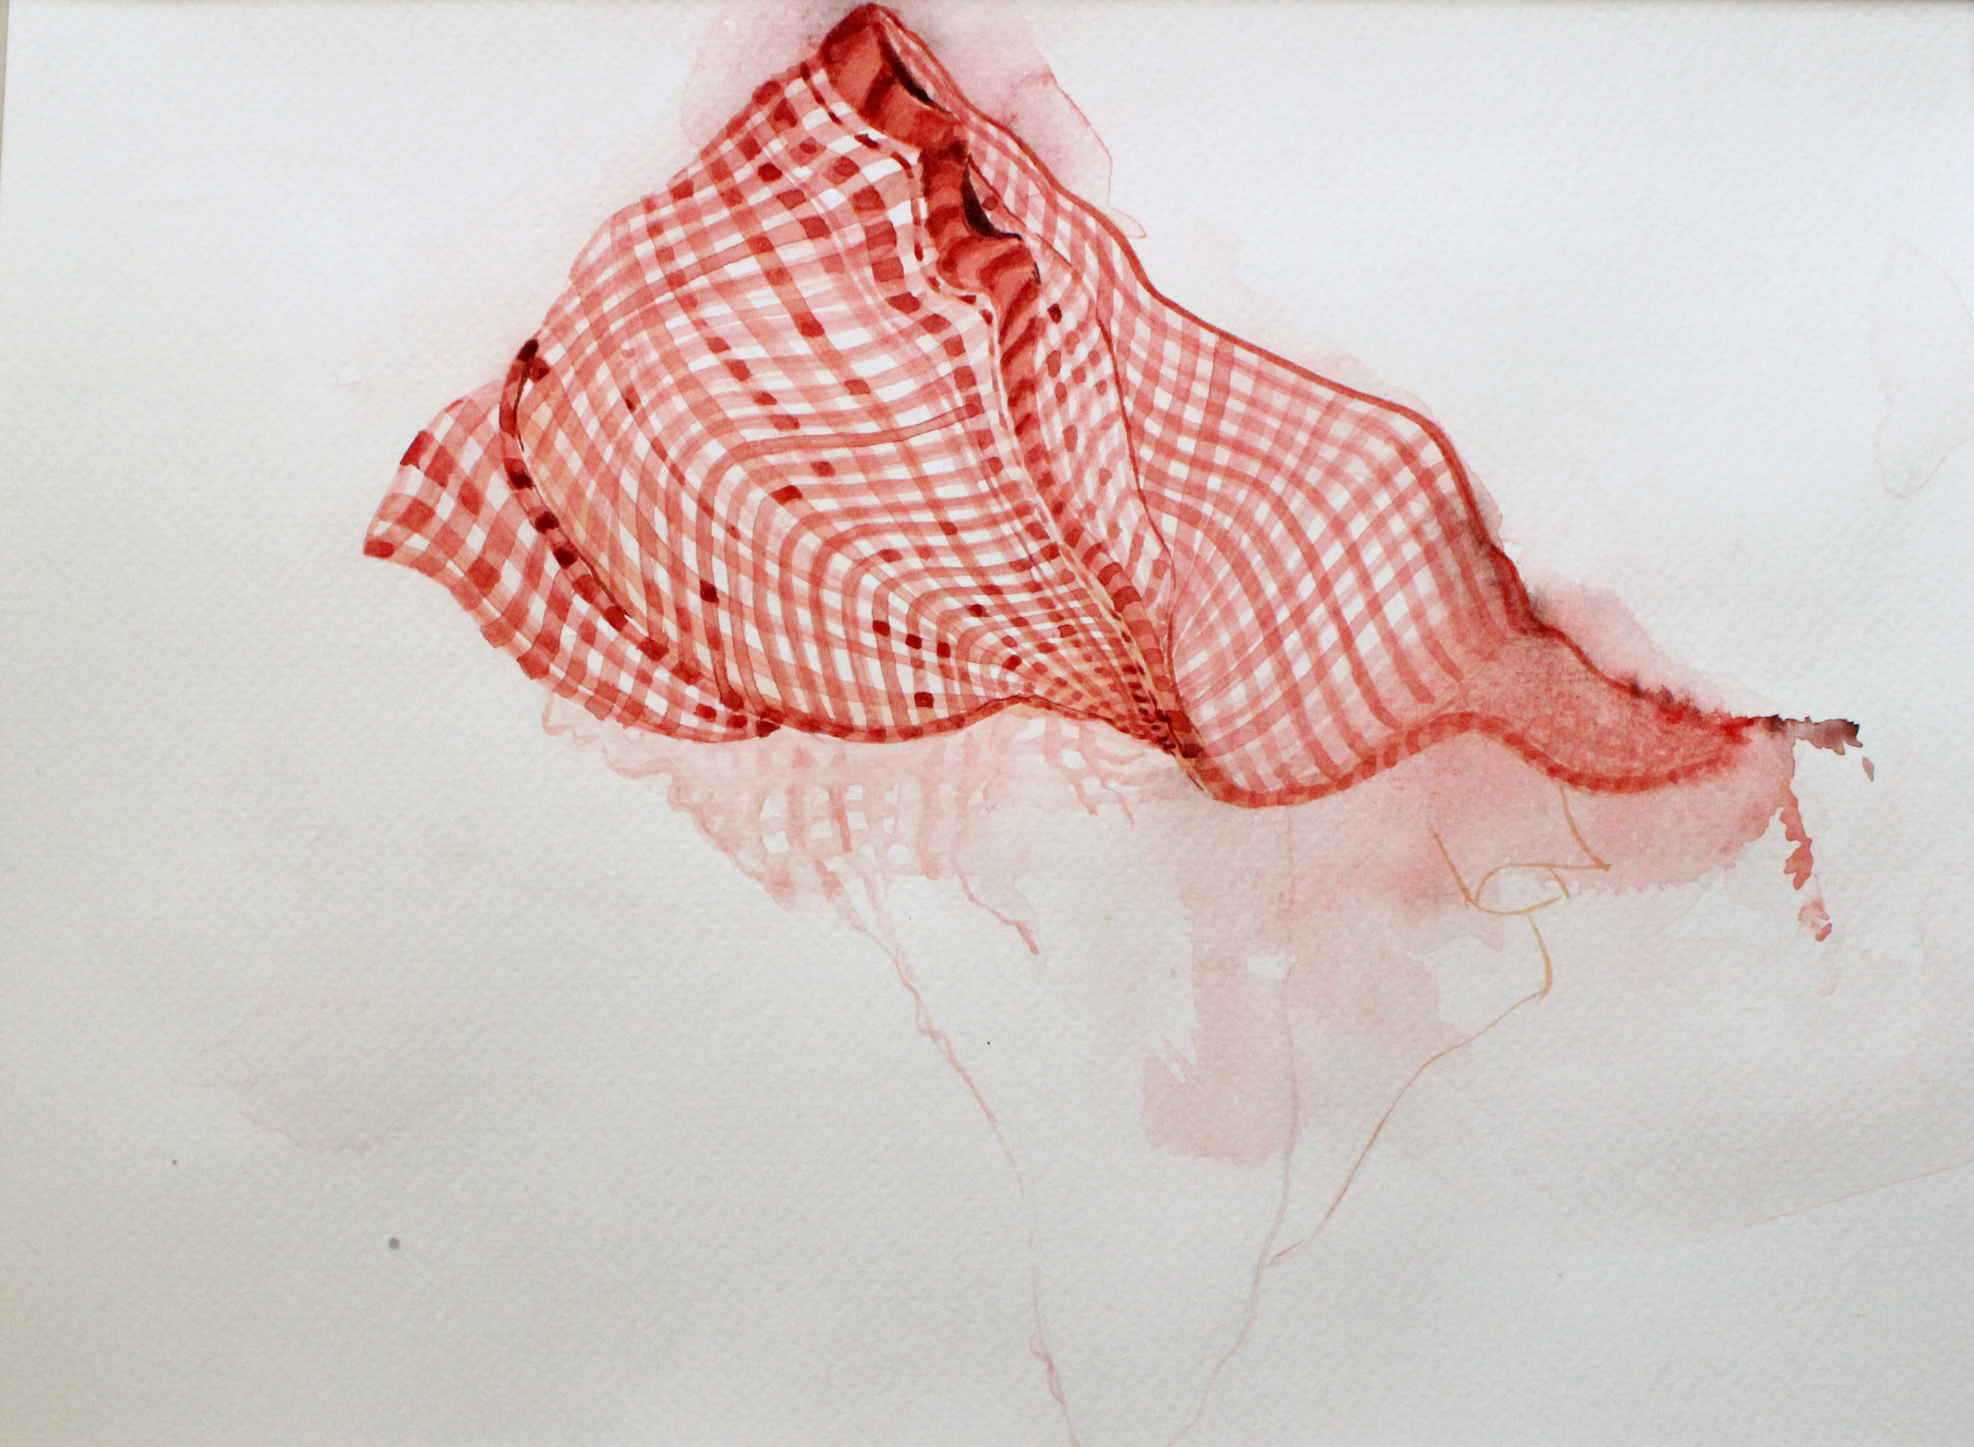

Slide 24
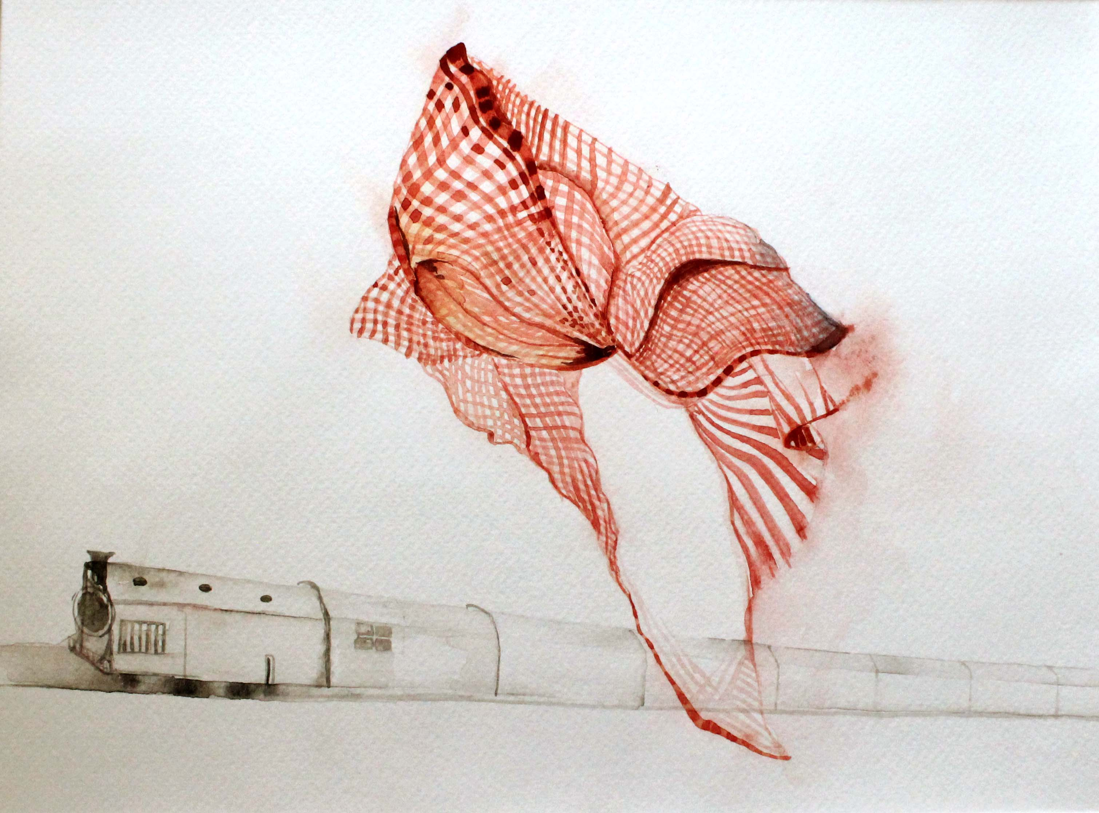

Slide 25
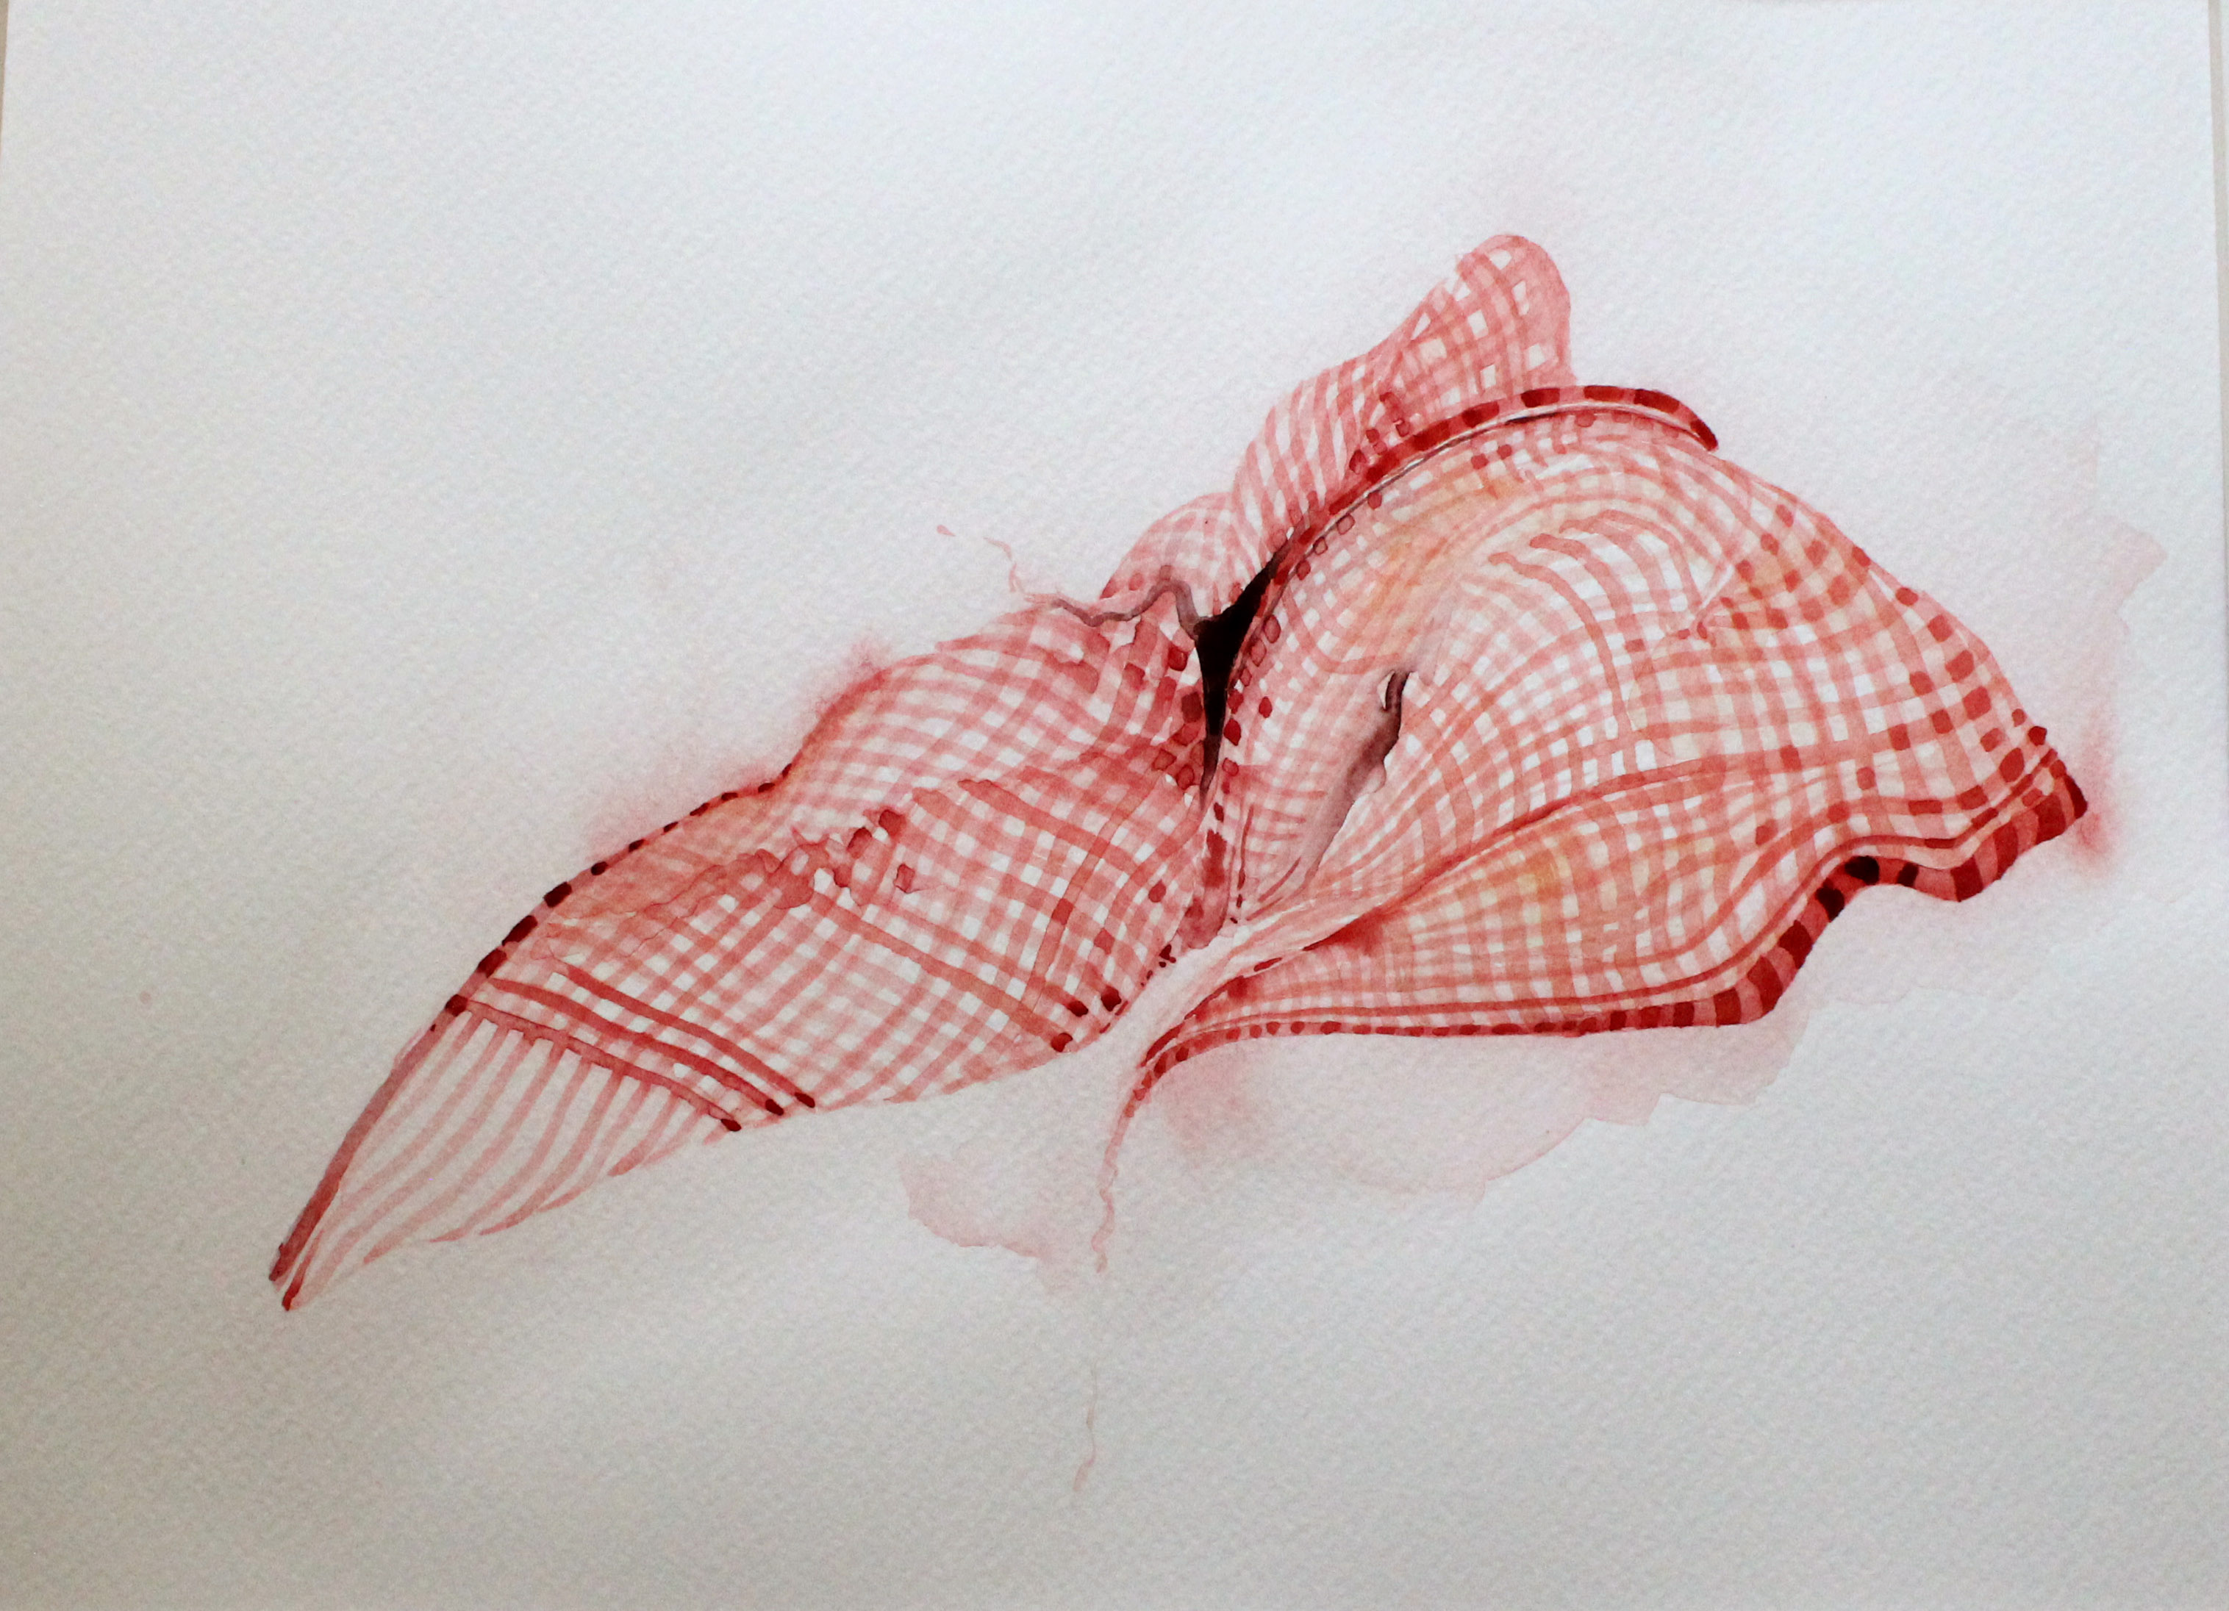

Slide 26
Poetry of Resistance

Slide 27
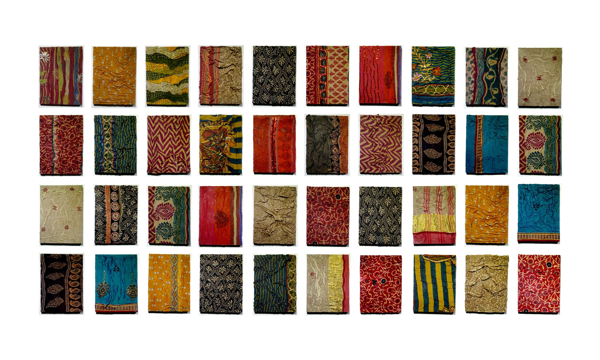
Portraits of women(Poetry of Resistance) 40 Frames of Installation, Collected Old Sari, 11 x 8 Inches, 2018-2021

Slide 28
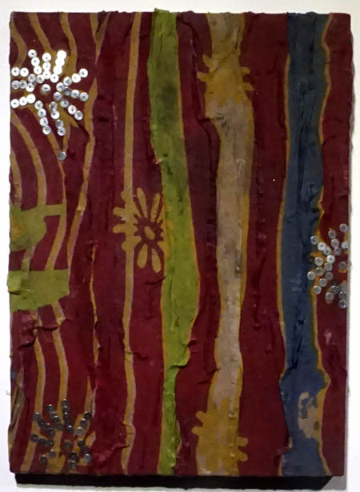

Slide 29
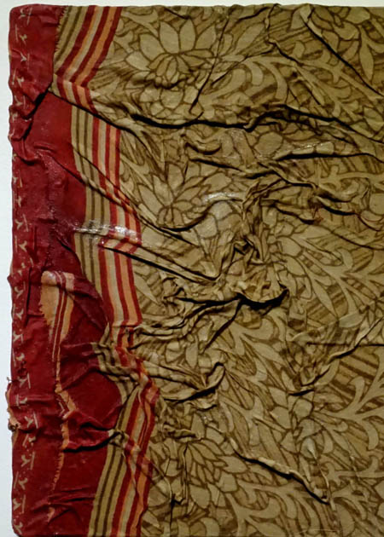

Slide 30
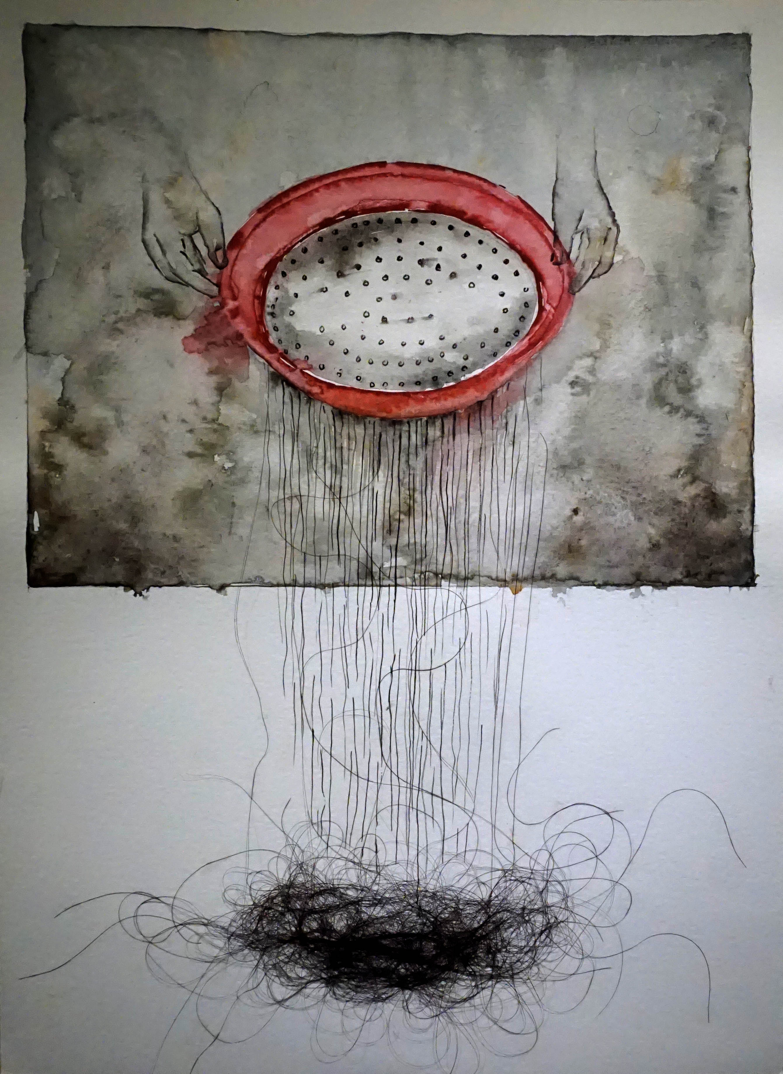
Poetry of resistance size 28 x 38 cm water color and fallen hair on paper 2018

Slide 31
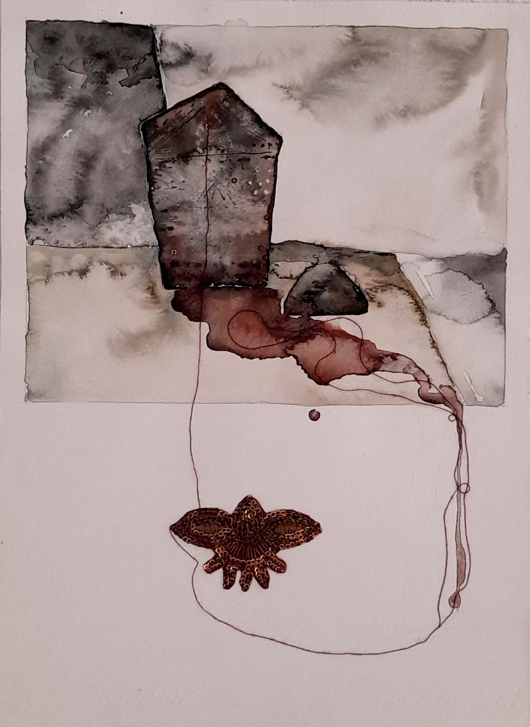
Poetry of resistance size 28 x 38 cm watercolor and cotton sari cloth on paper 2018.

